Slide 1
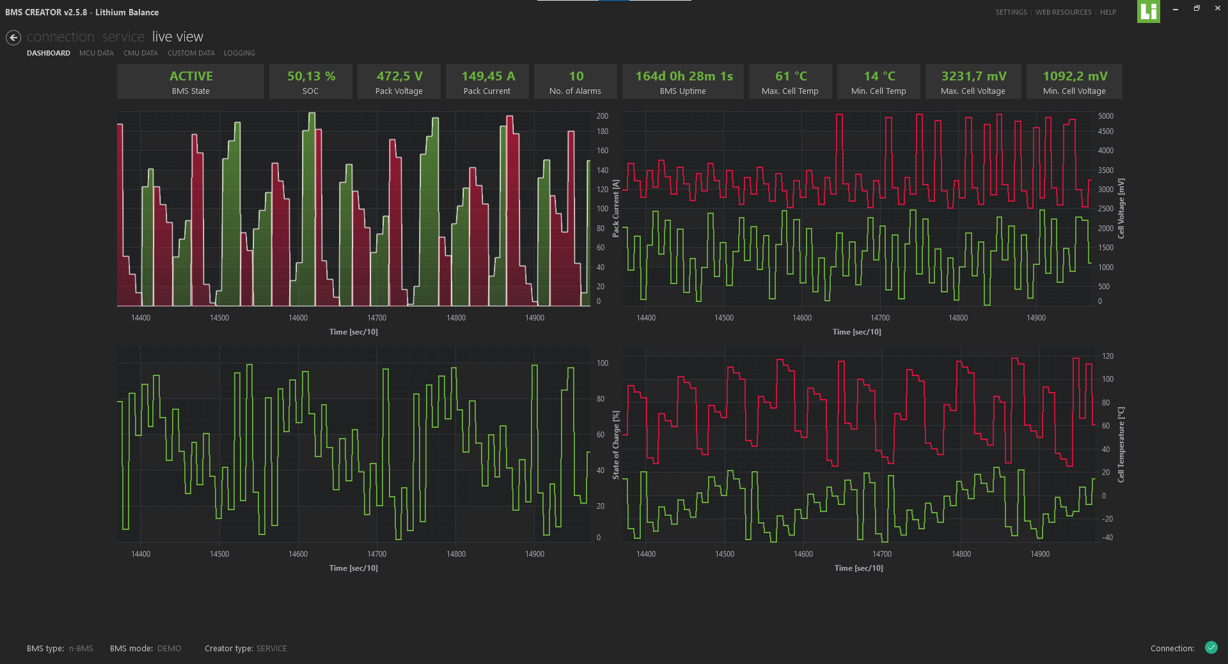
SERVICE
Monitoring & Field Servicing Software

Slide 2
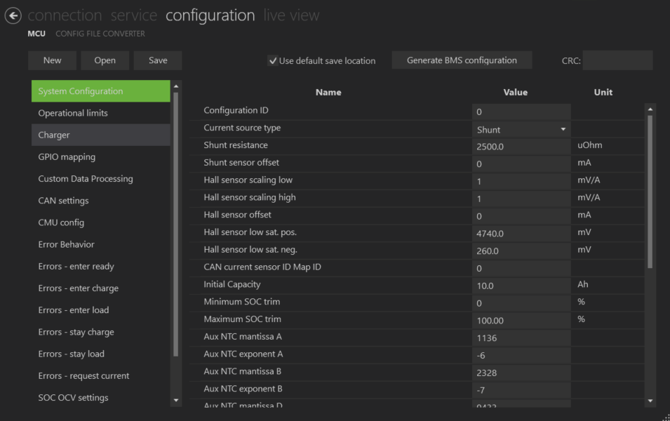
SERVICE is convenient addition to CREATOR for monitoring and servicing purposes
CREATOR
SERVICE
Configuration tool
Monitoring and field servicing tool
For engineers and R&D
Configuration, monitoring, and servicing
  Configuration
  Connection to the BMS
  Battery operation monitoring
  Software update and maintenance
  Troubleshooting
For service personnel, field agents, production, and supervisors
Monitoring and field servicing
  Connection to the BMS
  Battery operation monitoring
  Software update and maintenance
  Troubleshooting
Configuration options are locked and not visible

Slide 3




Service functions - monitoring and field maintenance
Connect & set up BMS
Connect / Disconnect the BMS from the PC
Confirm BMS type
Check BMS serial number
Verify firmware version
Monitor connection
Monitor battery operation
Live status monitoring
Cell Voltage, Pack Voltage
Current
Alarms / Warnings
Uptime
Cell temperature
On-site Software maintenance
Upload new BMS configuration previously created in a CREATOR
Update to new software version on-site
Bootload firmware
Set time and date in the BMS (for error log)
Synch time & date with PC
Troubleshoot
Access and read error logs
Reset the BMS
Save the error logs for further analysis / troubleshooting

Slide 4
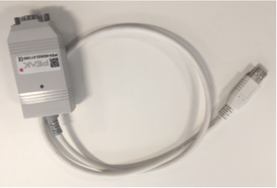
How to connect
Install the latest version of CREATOR on a PC
Activate SERVICE via lb_activation@sensata.com
Connect the BMS to the PC via a PeakCAN adapter
Open CREATOR with the activated SERVICE license
The BMS should be detected by the software
Press Connect on the ”Connection” tab

Slide 5
Breakdown of features

Slide 6
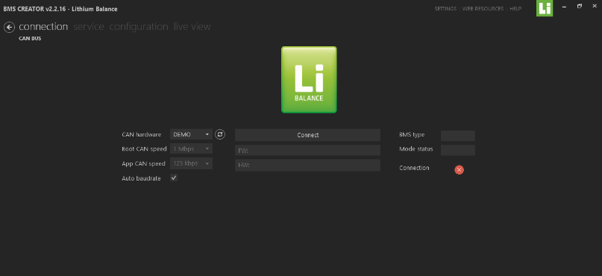
Communication Connection
Connect/Disconnect the BMS from the PC
Check the type of BMS connected, its Hardware serial number & the firmware version
Possible to check the connection status of the BMS & PC

Slide 7
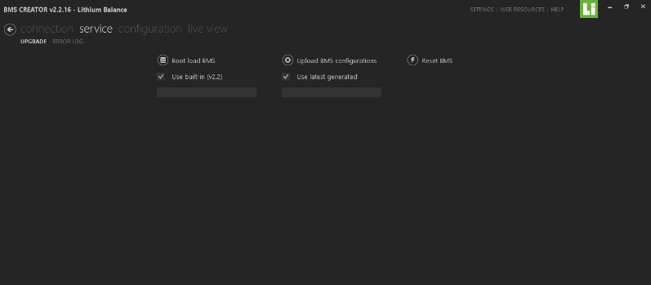
Service
Bootload the BMS to upgrade to new software versions
Upload previously saved BMS configuration file
Reset the BMS

Slide 8
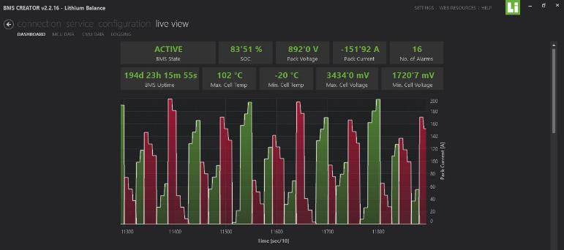
Live View
This window shows the complete overview of the system status and parameters such as
BMS state
SOC, Pack voltage, Pack Current, Number of alarms, BMS uptime, Cell Min./Max. temperature & voltages
Graphs of charging & discharging current, min/max cell voltage, temperature, SOC vs time

Slide 9
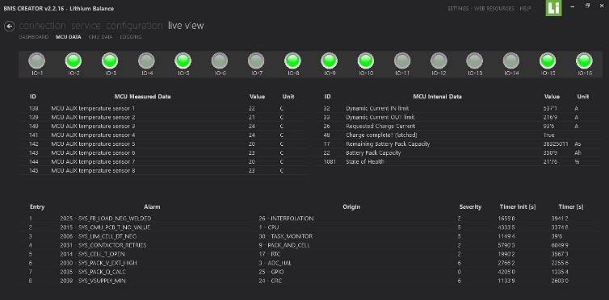
BMS board data
GPIO status
Temperature data
Current values
Cell voltage data
The errors that are present in the system

Slide 10
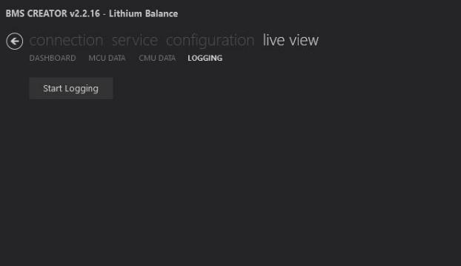
Logging
Access and read error logs
Save the error logs for further analysis / troubleshooting

