Slide 1


0,117,194
171,205,3
47,47,47
Fullness
60%
Intelligent Cargo solution
Remaining
53m³
2024
Guardians of Road Safety
Streamax Technology Co.,Ltd.

Slide 2

Potential & Profitable Market
15.25 Million Trailers
Dry Van Trailer
North America
33.4%
Russia/CIS
6.6%
Europe
18.1%
Asia
26.2%
Latin America
9.2%
Middle East and Africa
6.6%

Slide 3
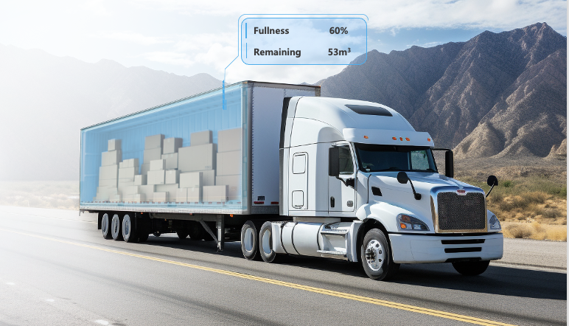

Inefficiency in Trailer Operation
Huge Inefficiency in
Trailer Operation
43% Of Truckloads Moved Partially Empty
1.94% Average Damage Rate In 2023
1 In 43 Shipments Was Impacted By Theft
Flock Freight & Drive Research

Slide 4



Intelligent Cargo solution
Order Matching
Cargo Loading
In Transit
Identify Closest Trailer
Volume Based Load Matching
Cargo Occupancy Measurement
Loading Process Monitoring
Unusual Activity Detection
Ultra Fast Wake Up for Recording
Long-life Location Tracking
Asset Utilization Reporting
Low Battery Notification
Cargo Occupancy Measurement
Unloading Process Monitoring
Parked
Cargo Unloading

Slide 5

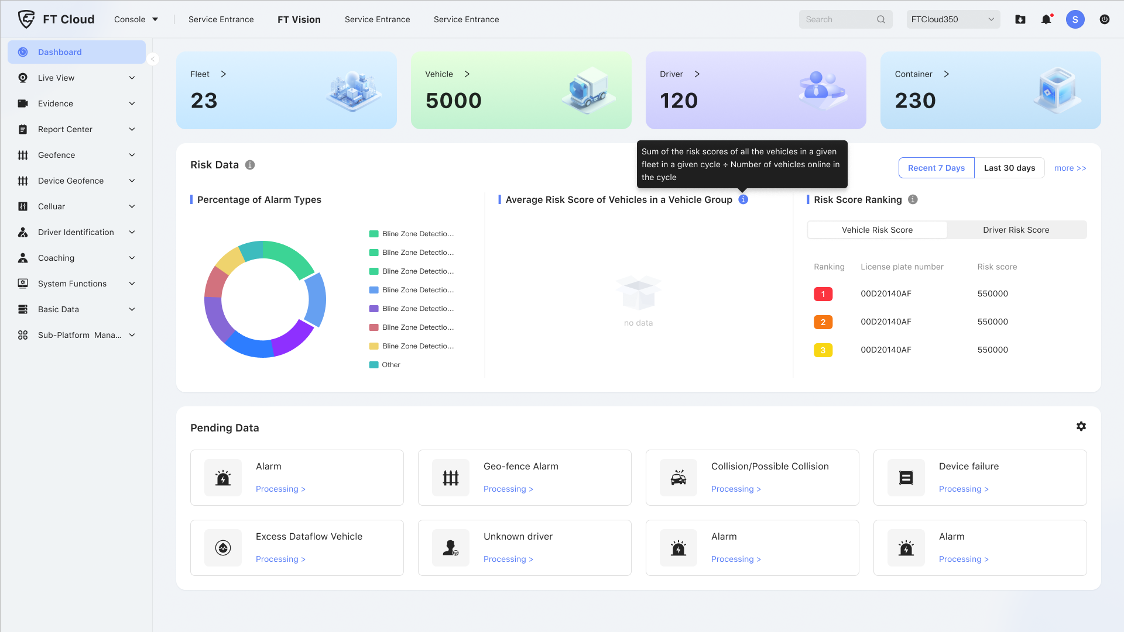
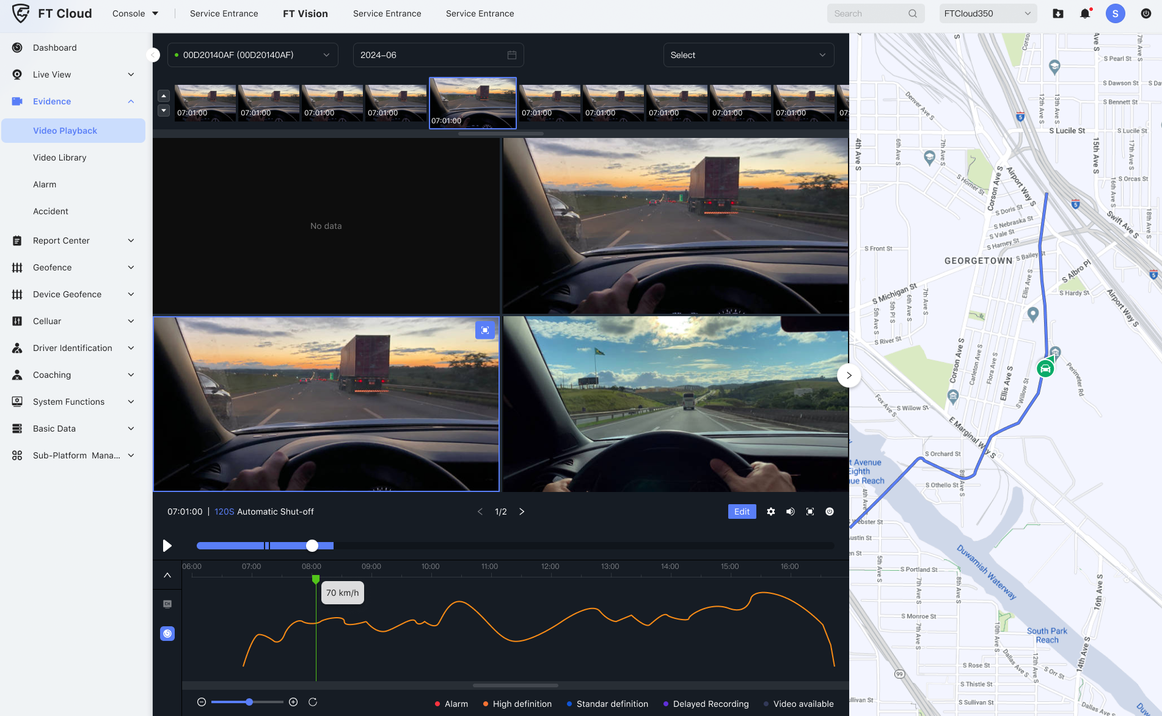
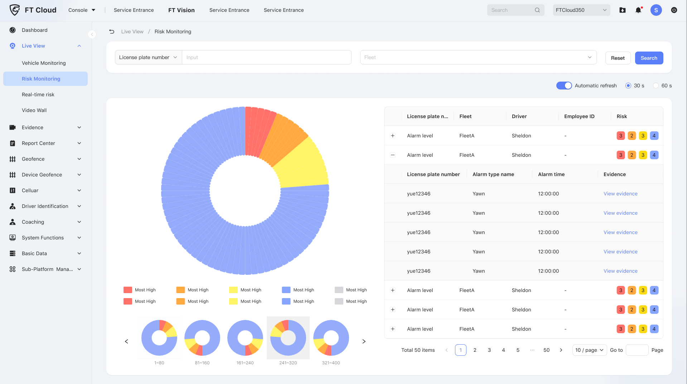

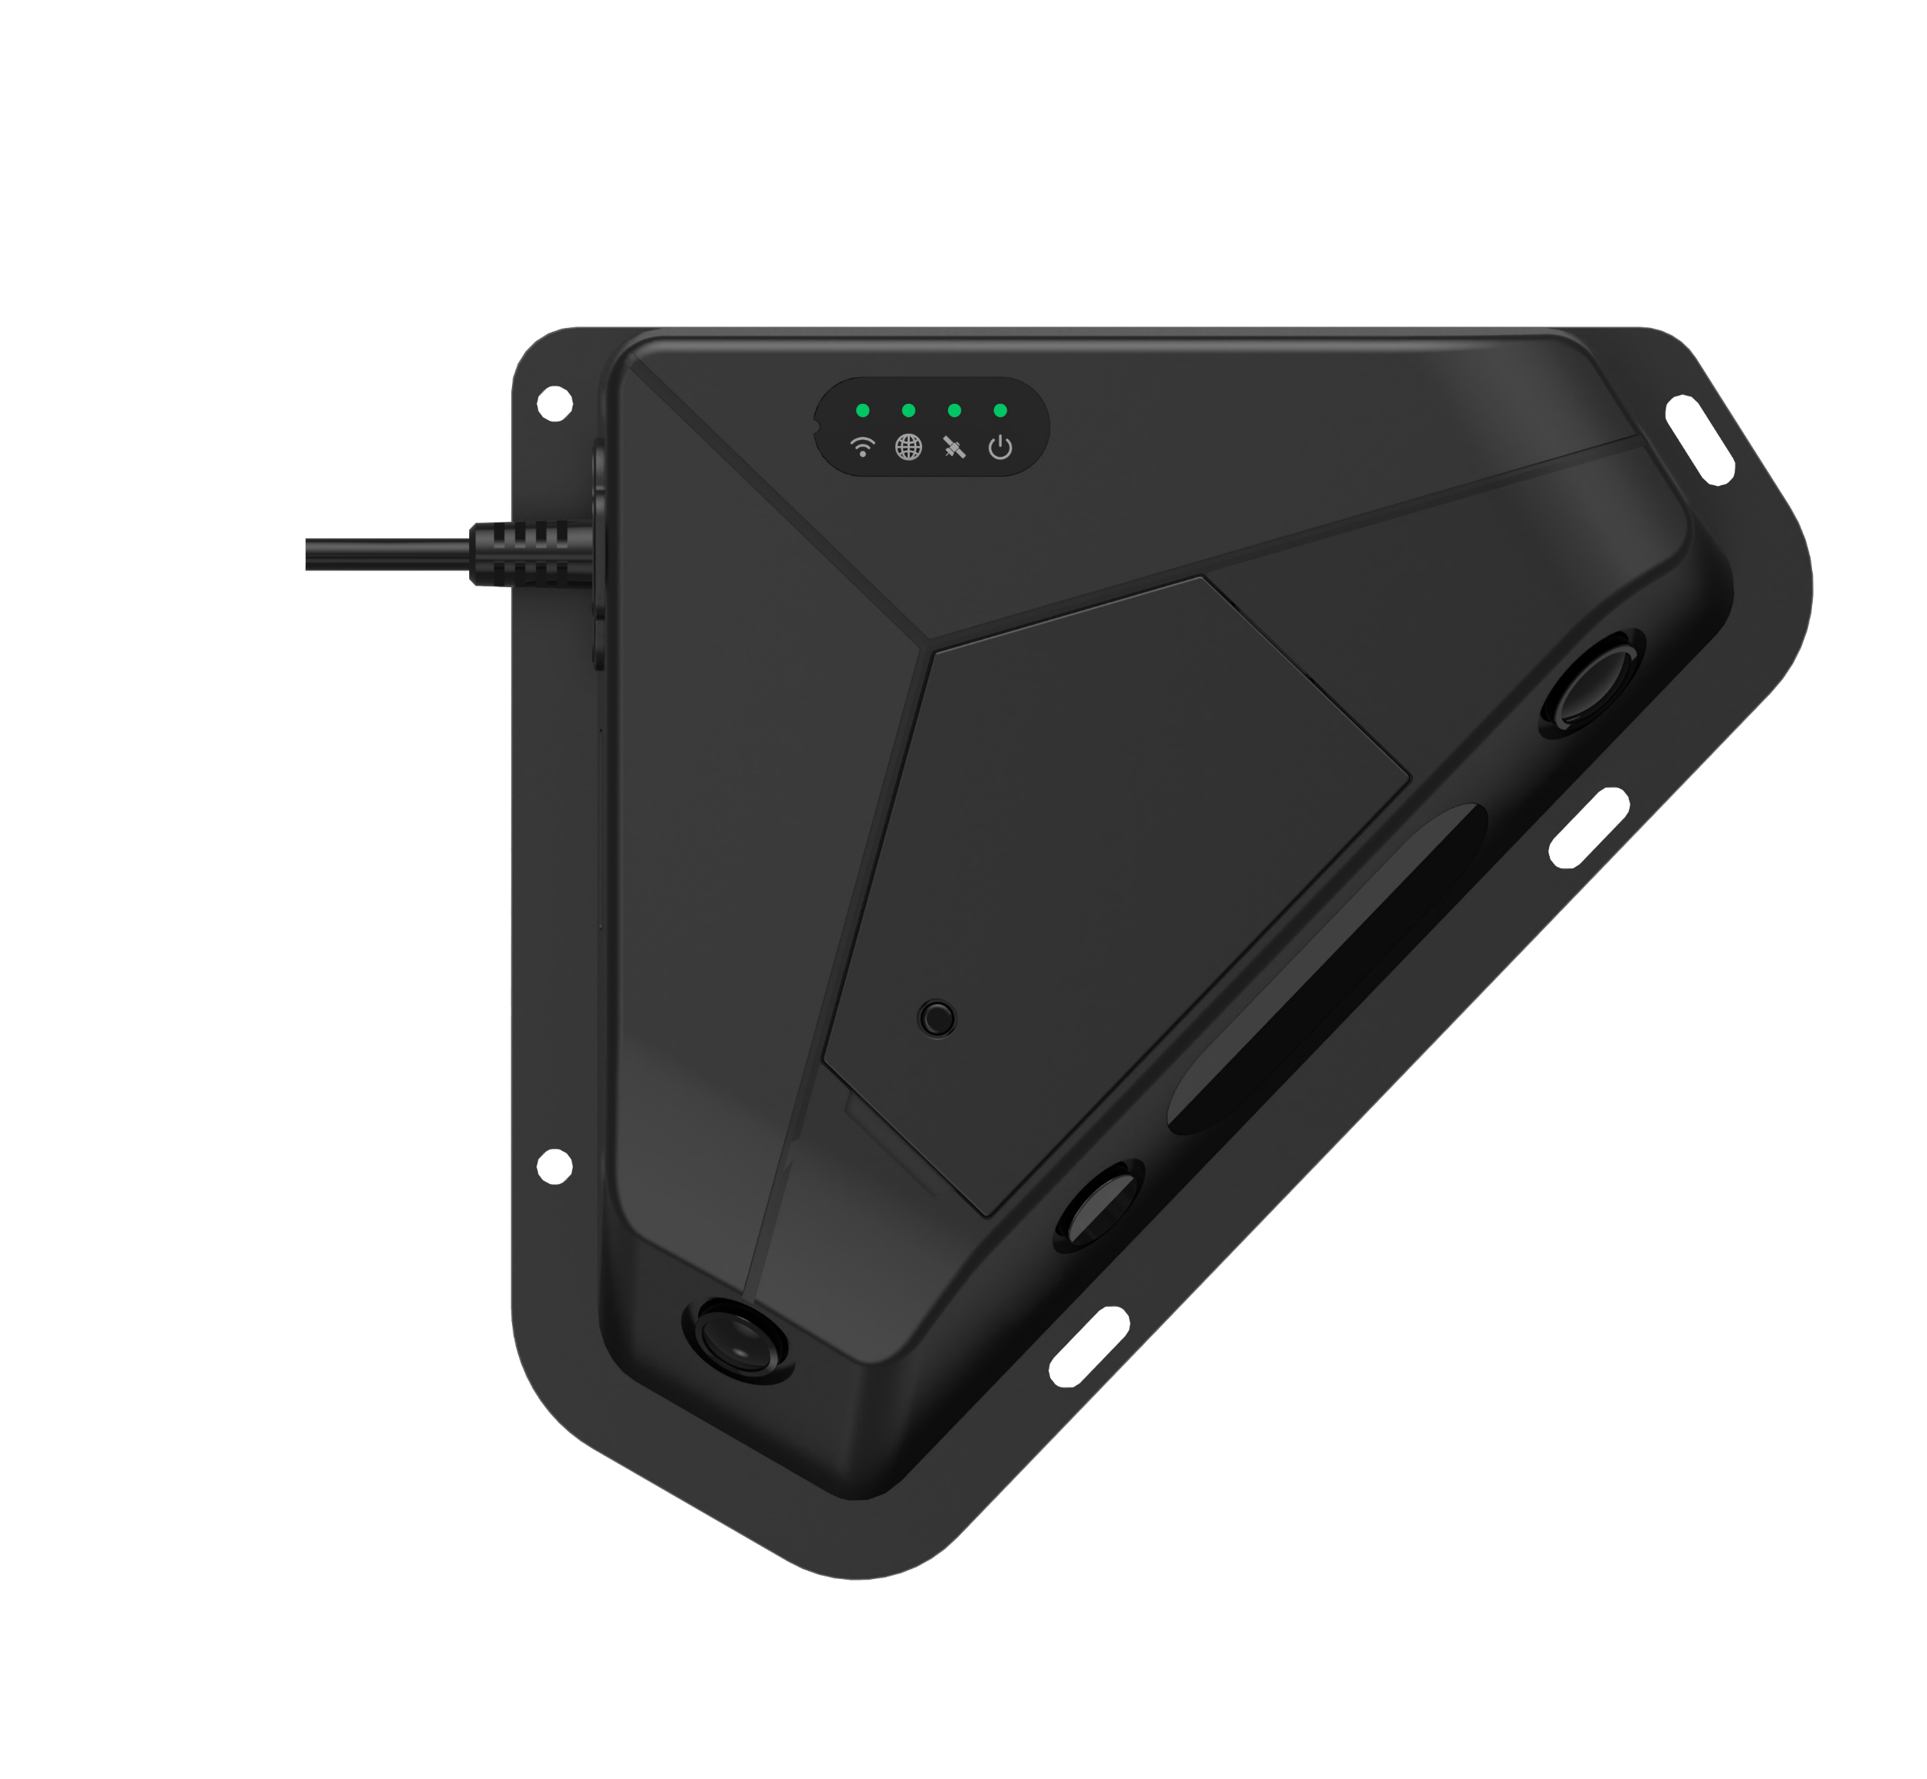
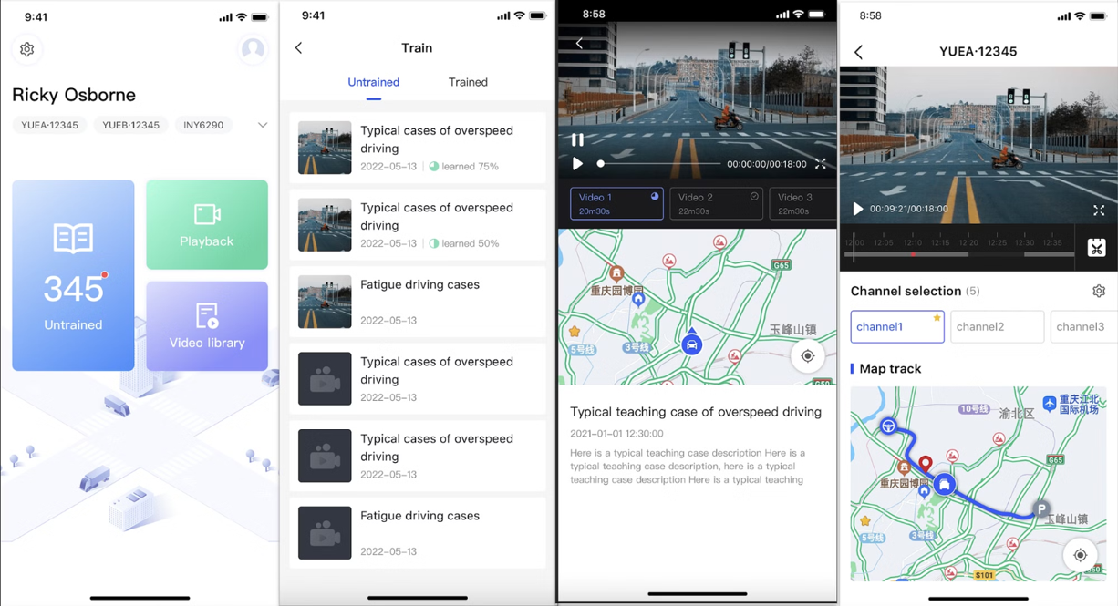

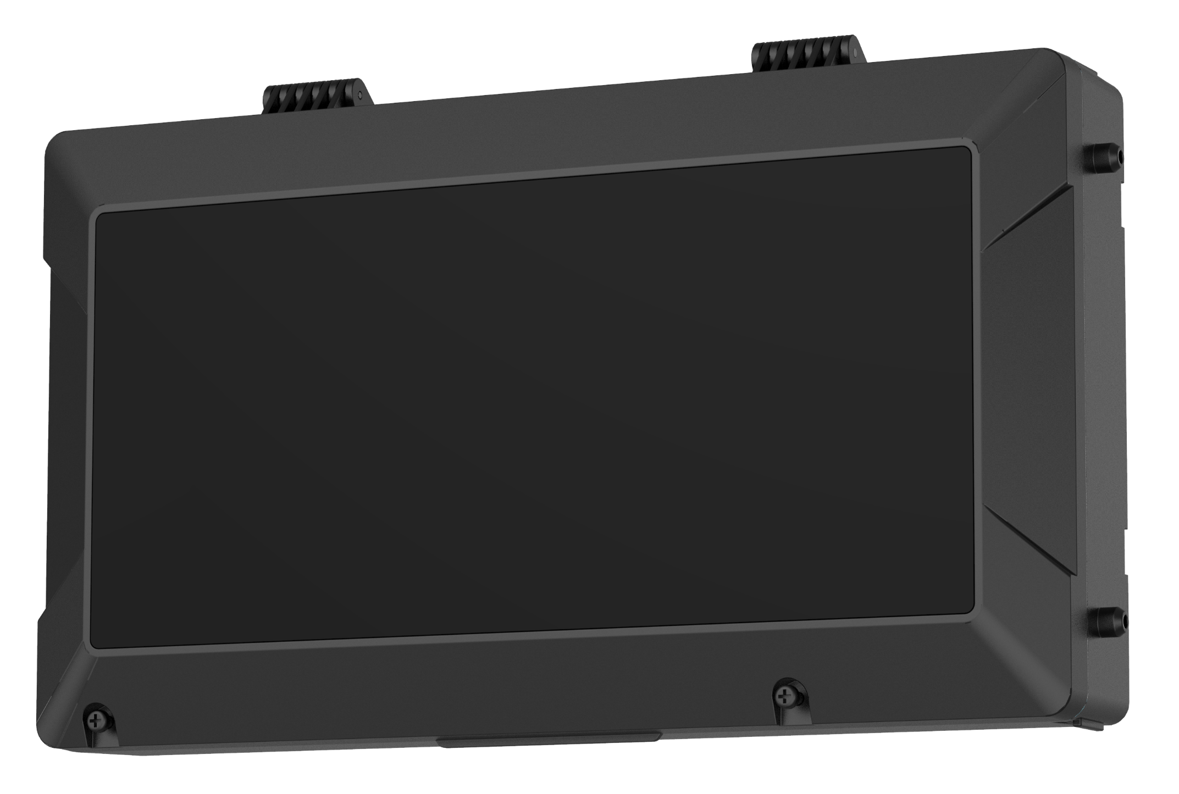
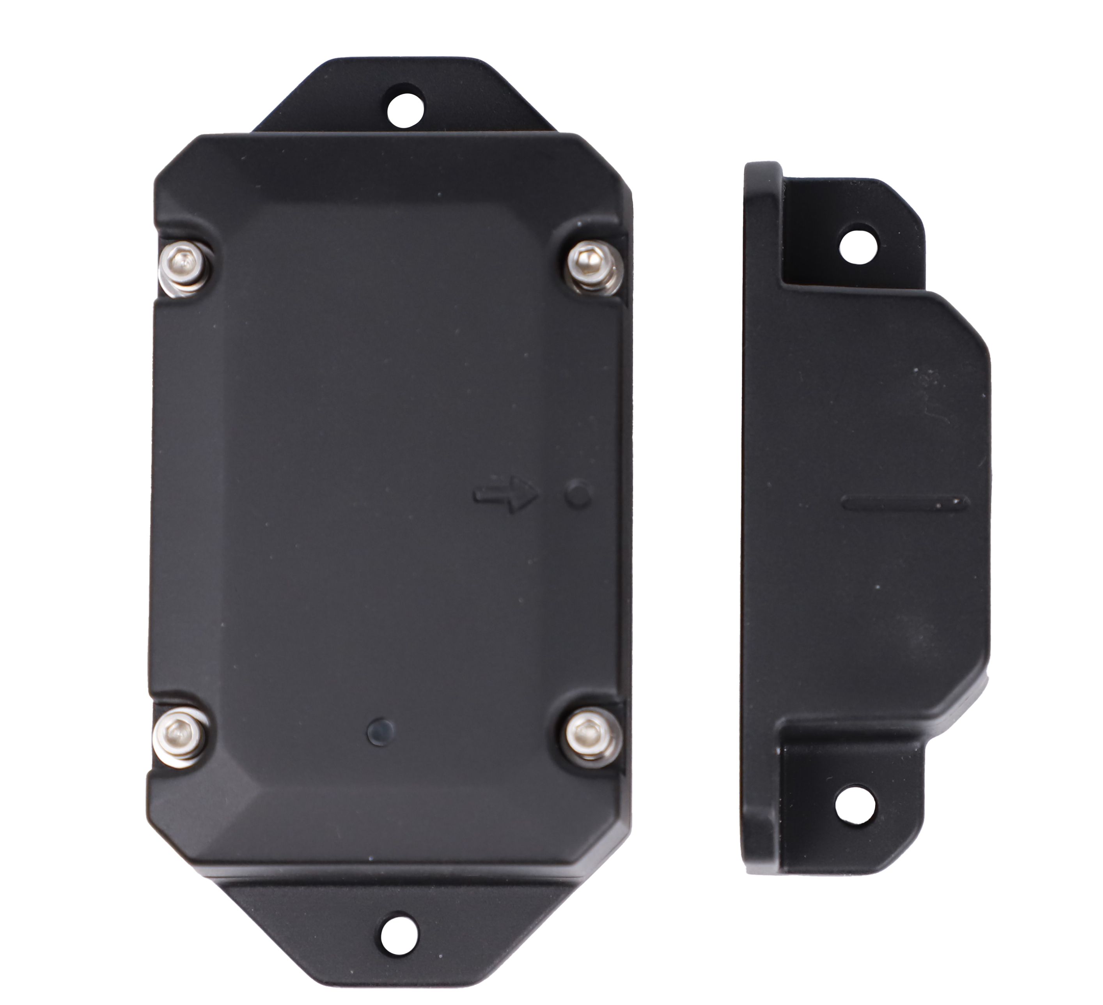

Intelligent Cargo solution
Transportation Efficiency
Reduce Empty Miles
Reduce Idle Days
FT Cloud & API
Cargo security
Record Cargo Damage
Identify Cargo Theft
Veyes
FT APP
Z5
ABS Box
Door sensor

Slide 6


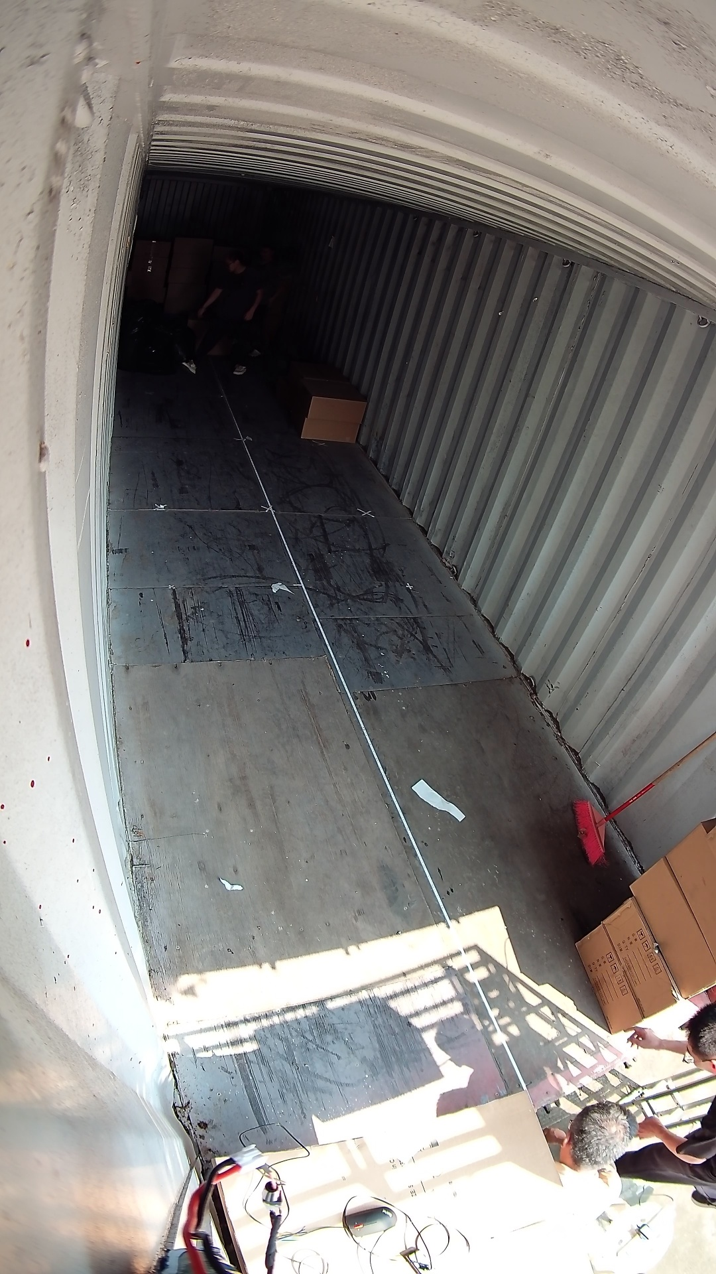
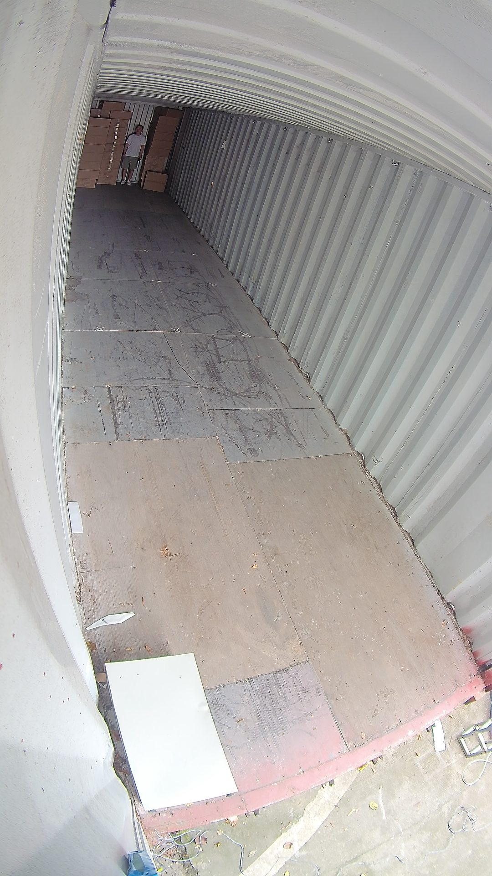

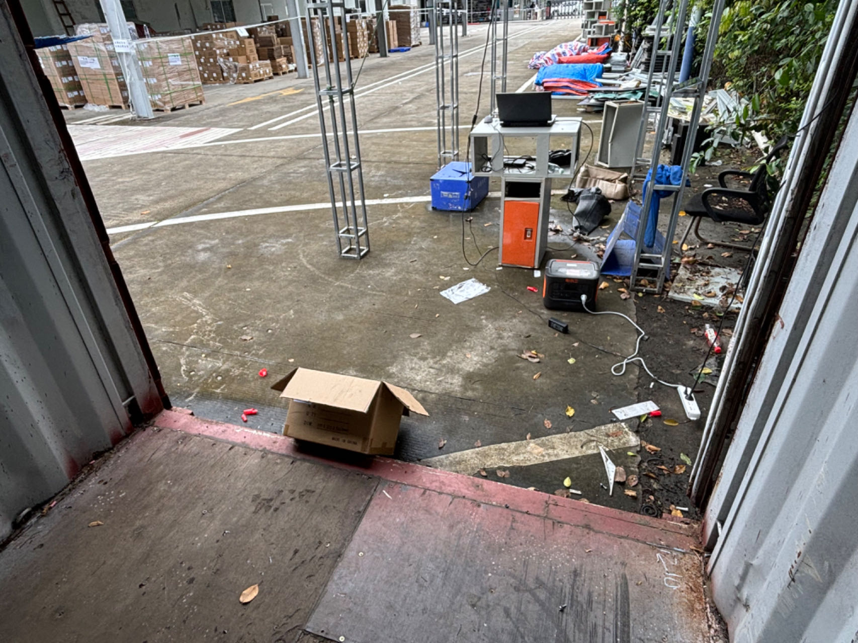
Z5-Trailer Security & Efficiency Camera
Dual lens all-round cover of cargo box，4K High resolution technology
LED
High
Resolution
Ultrasonic sensor
Rear Camera
4K Resolution
Similar product
VS
Notes:
同样13m长货箱

Slide 7

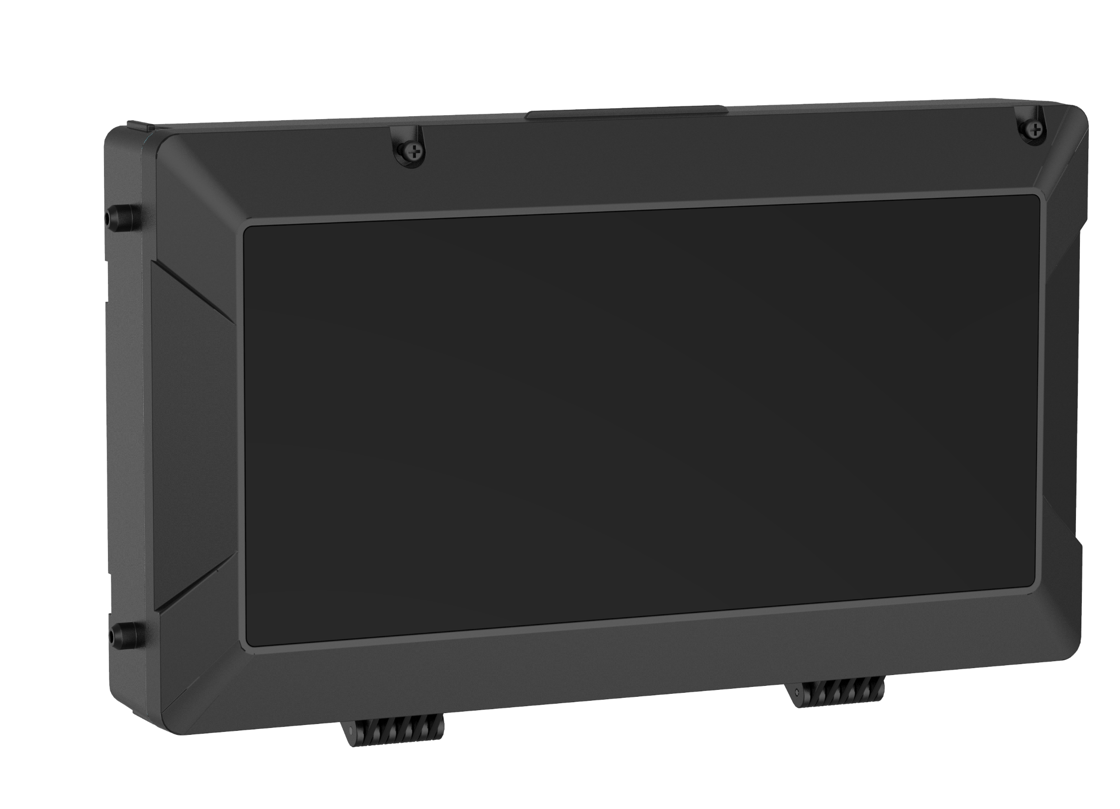
ABS Box
Solar Panel + Battery + Antenna(Wi-Fi + Bluetooth + Cellular)
Antenna
Battery
Solar Panel
ABS Box

Slide 8


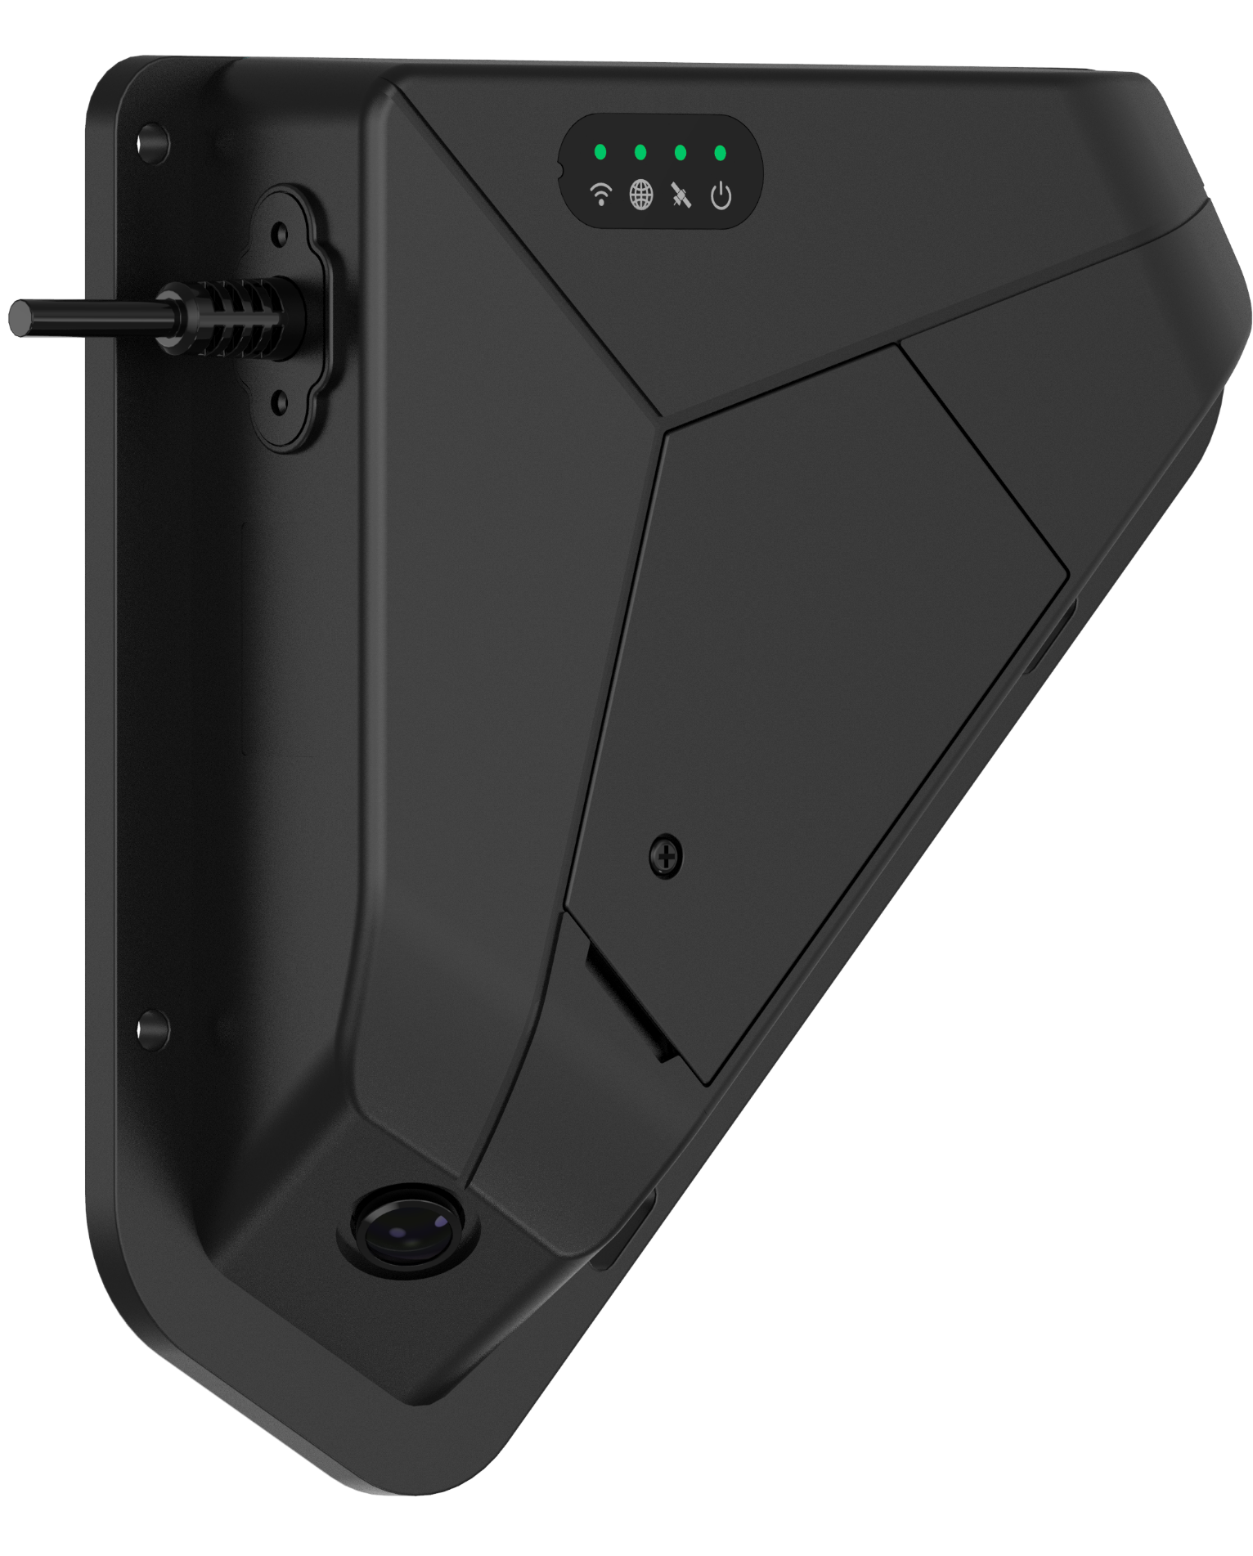




Centralized IoT Gateway for Trailer
Door
Sensor
RS-485
(By Bluetooth)
I/O Interface
WIFI
RS-232
The Z5 seamlessly connects to a range of wired and wireless interfaces, including Bluetooth, WiFi, RS-232, and RS-485, allowing for versatile adaptation to different environmental requirements. It integrates effortlessly with numerous third-party sensors, enabling precise monitoring of all conditions within the cargo box.
Bluetooth

Slide 9
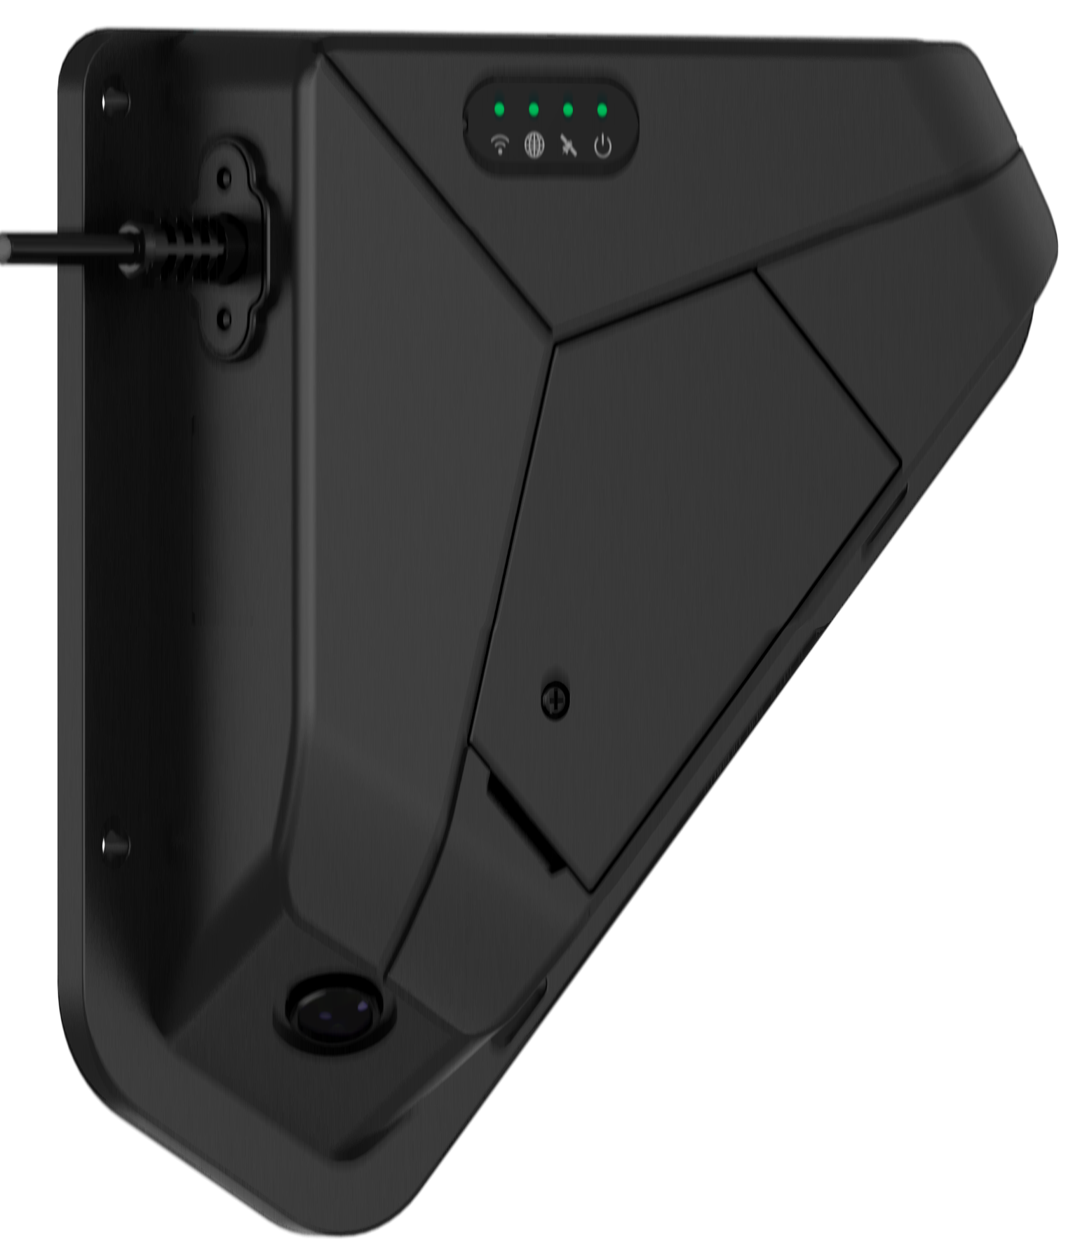
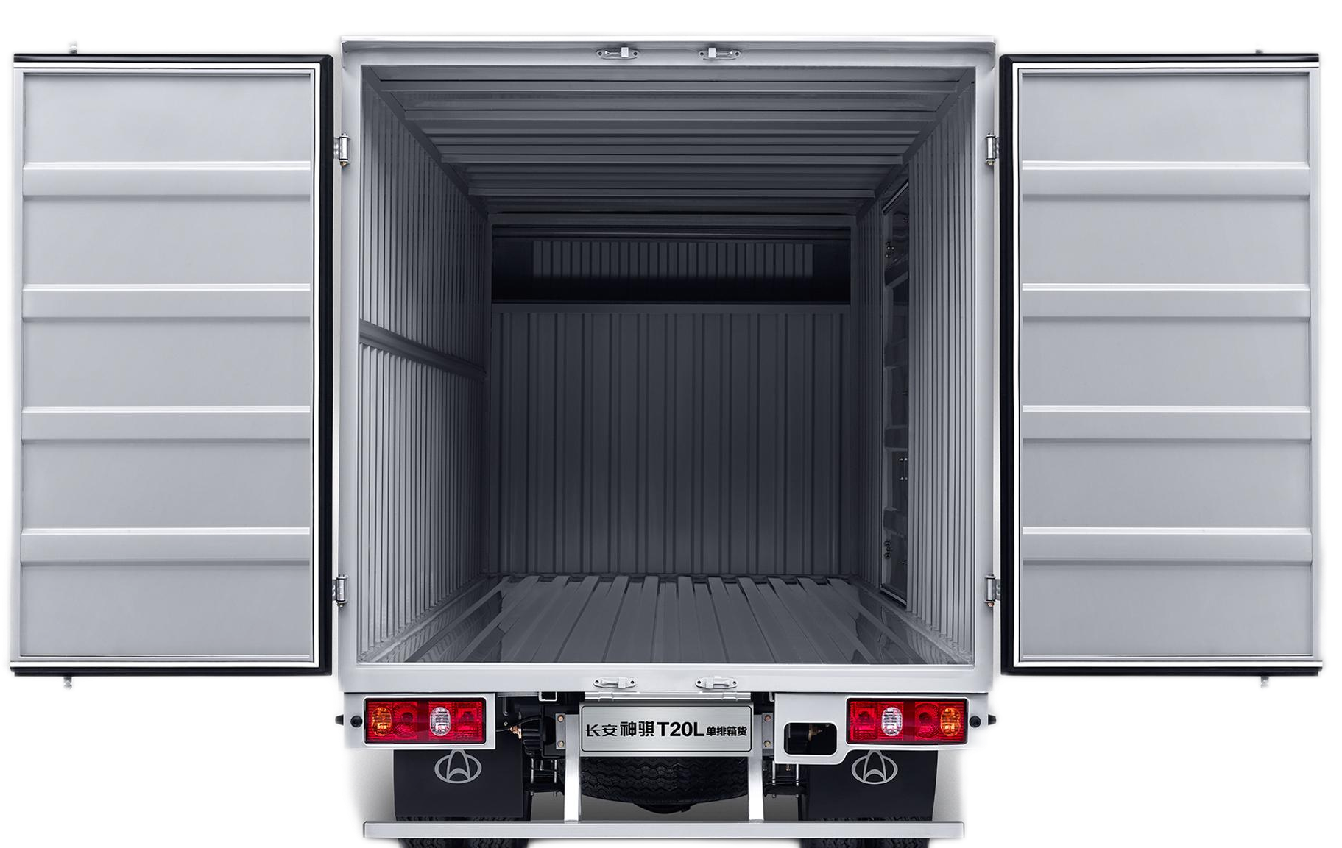

Installation Diagram
Inside
Outside
Cargo Camera
Solar panel + battery +Antenna(GPS+4G+wifi)

Slide 10
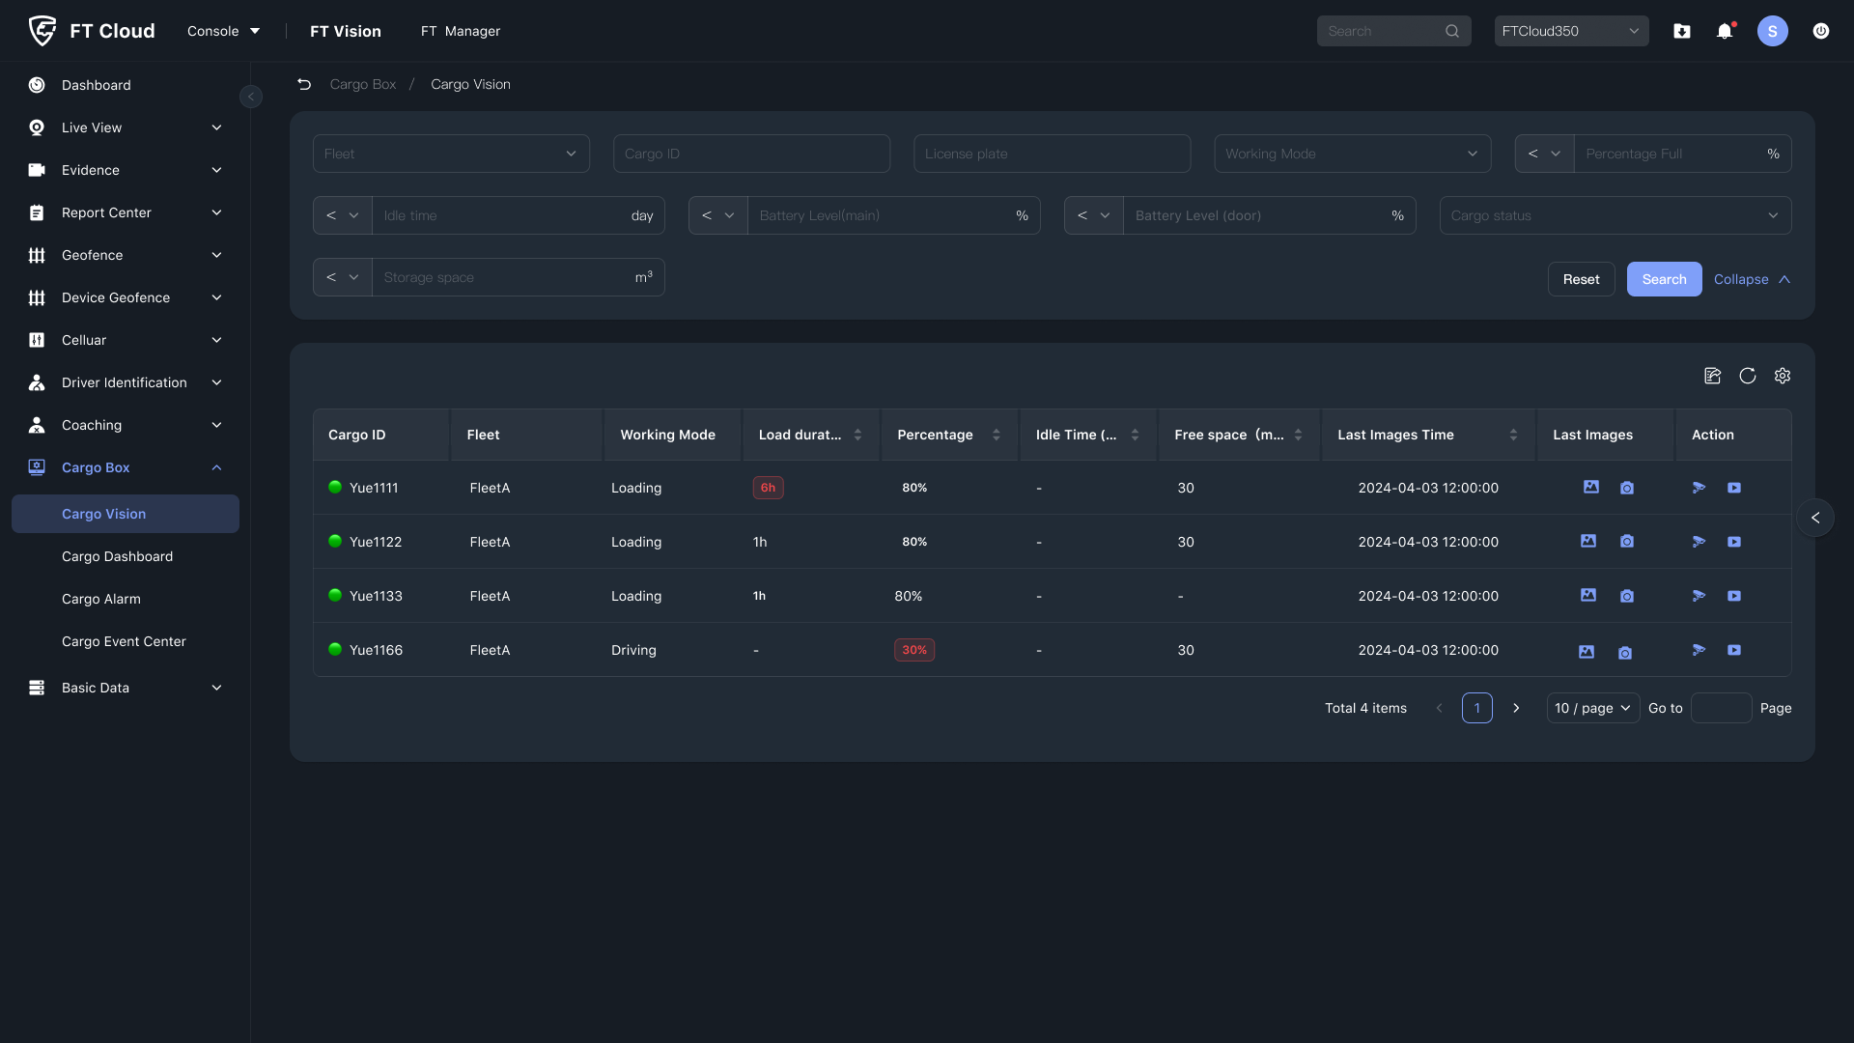
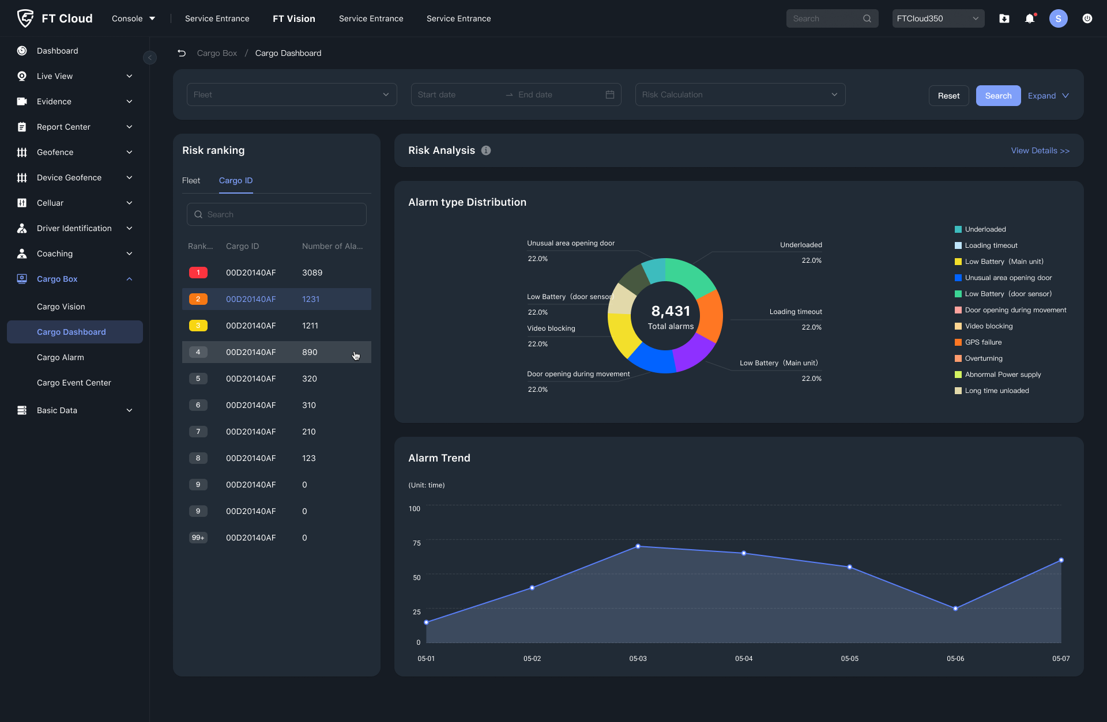
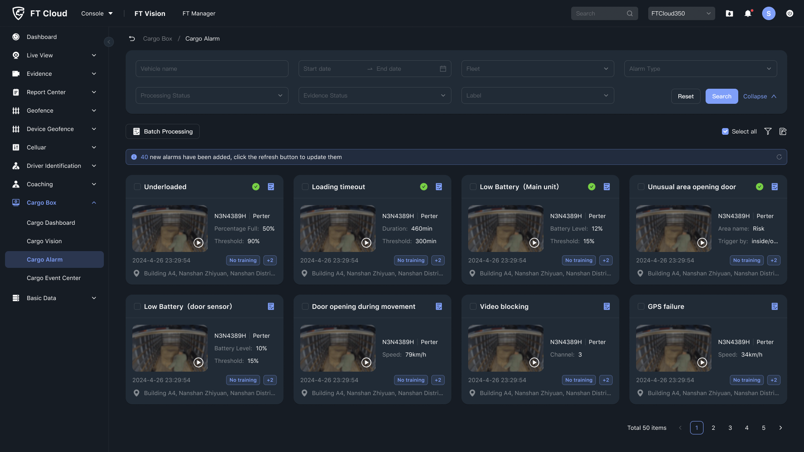
FT VISION
Real-time Display Of Data, Assisting Decision-making; Data Analysis Helps Upgrade Management
Cargo Vison
Cargo Dashboard
Cargo Alarm
By integrating and analyzing data such as images, videos, cargo capacity, GPS, etc.,we provide operators with one-stop web operations
One page webpage displays a panoramic view of data, summarizing, categorizing, and analyzing content to help improve management
Retain and clearly display all cargo data by category, in real-time and conveniently, to facilitate efficient cargo capacity
Notes:
高触发

Slide 11
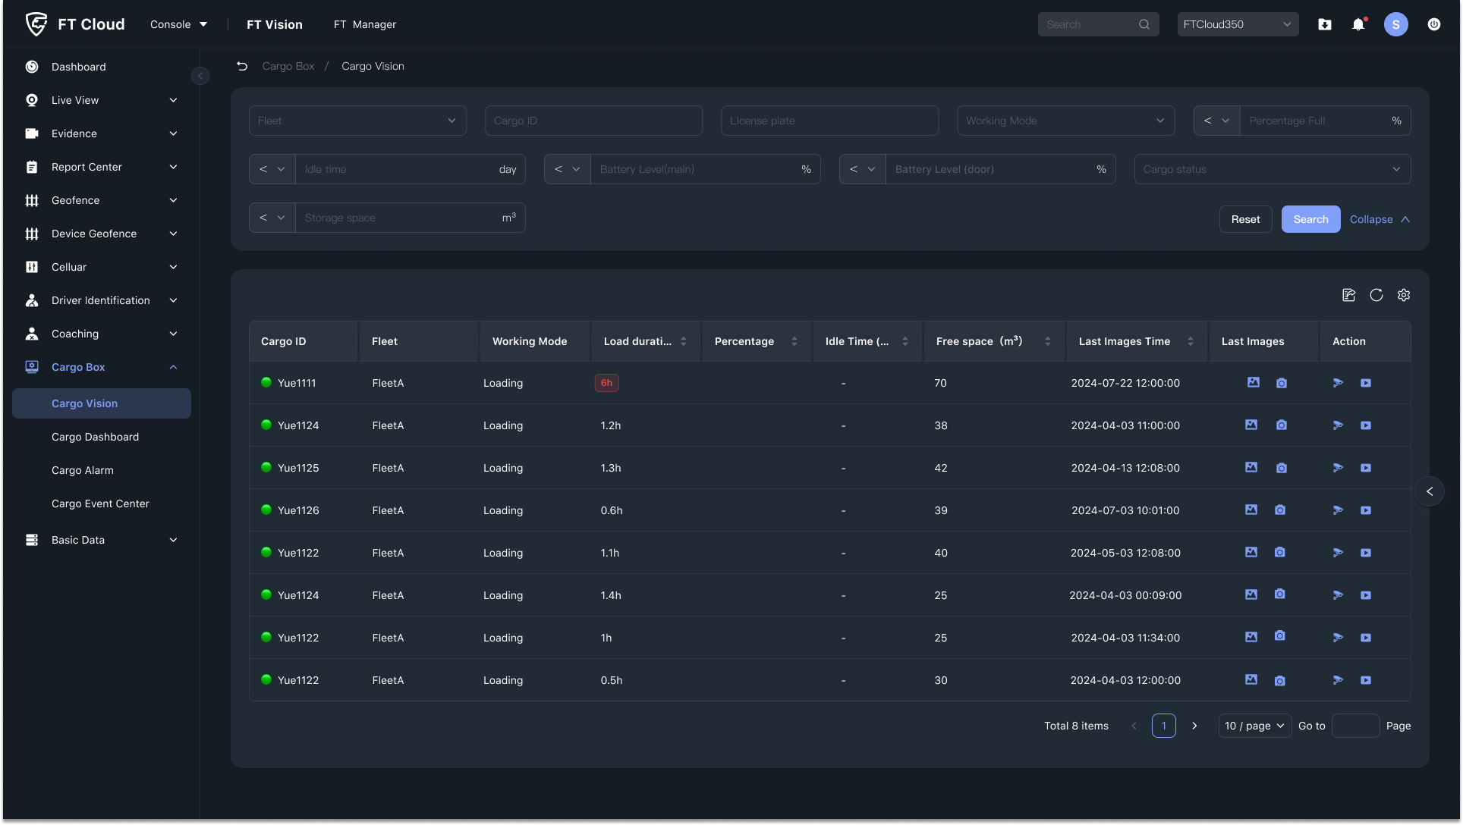
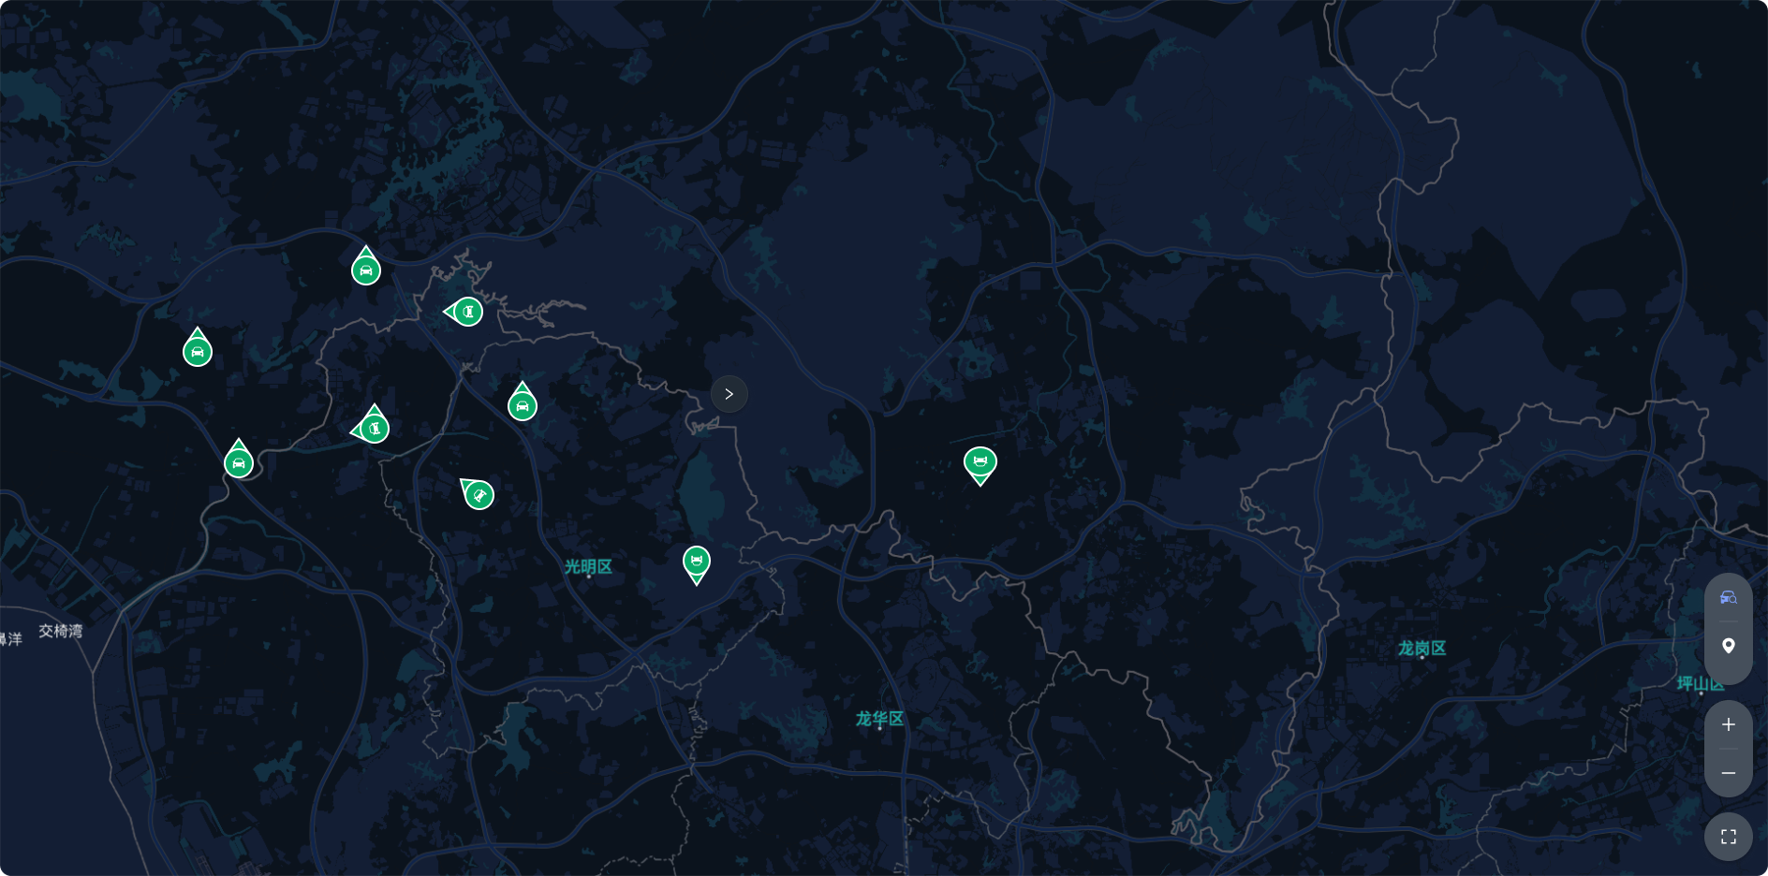
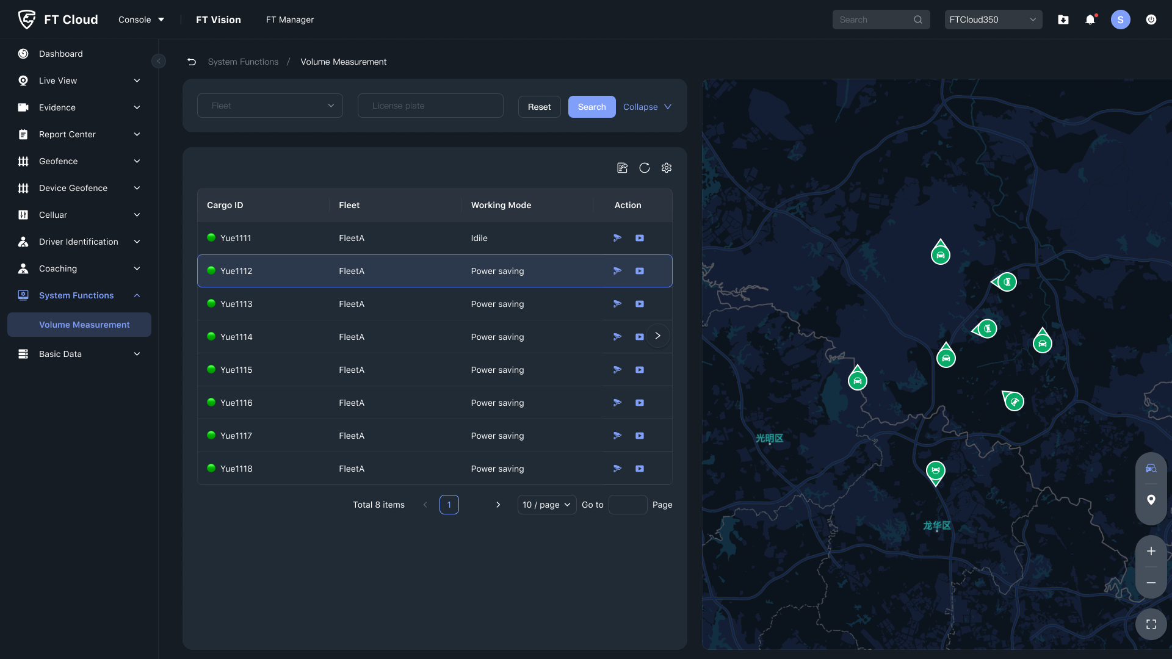
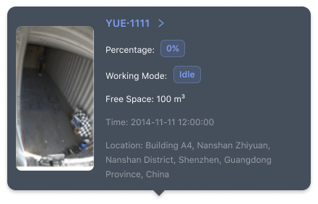
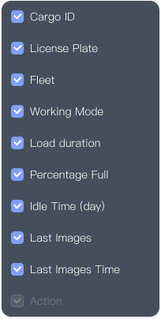














Cargo Vision
30%
80%
75%
45%
50%
100%
74%
30%

Slide 12


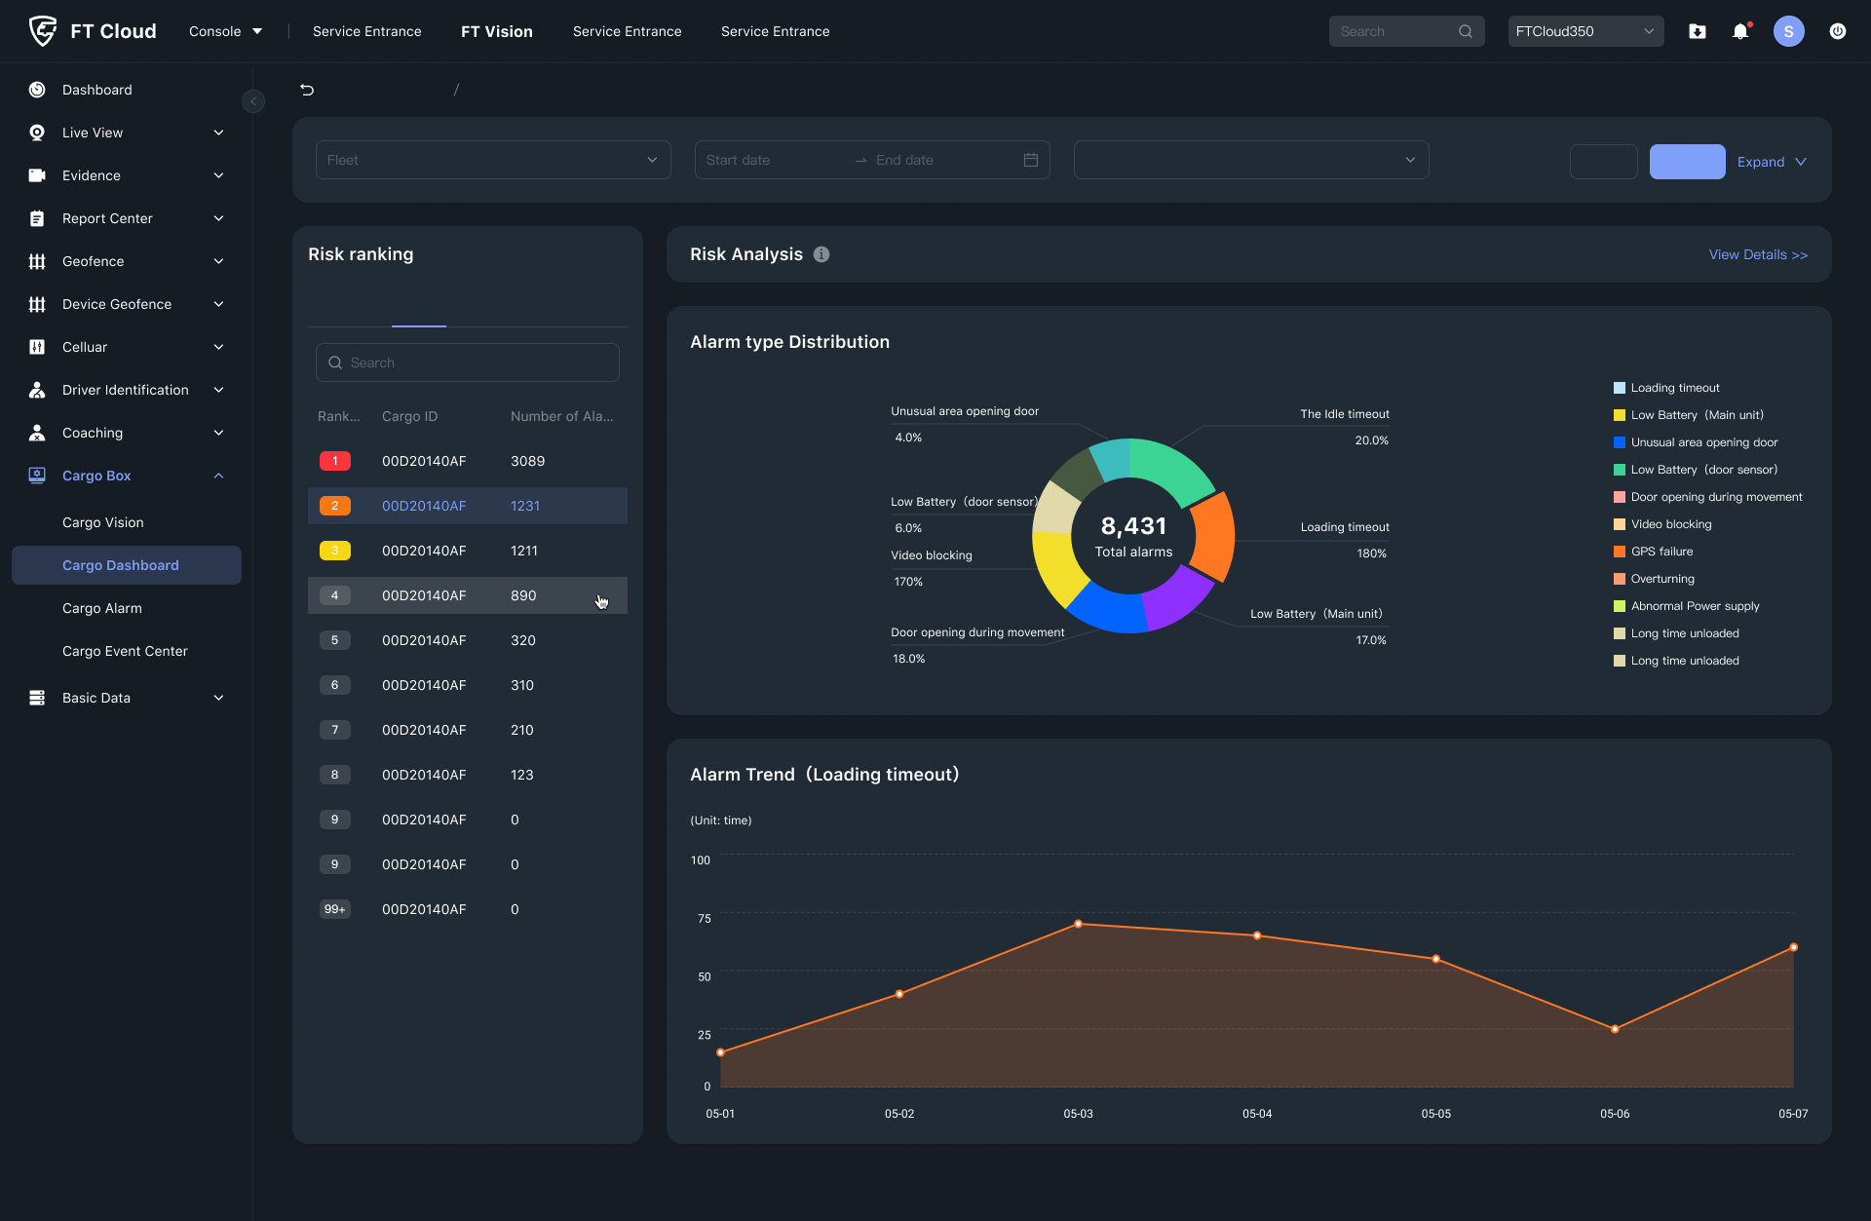
Cargo Dashboard

Slide 13
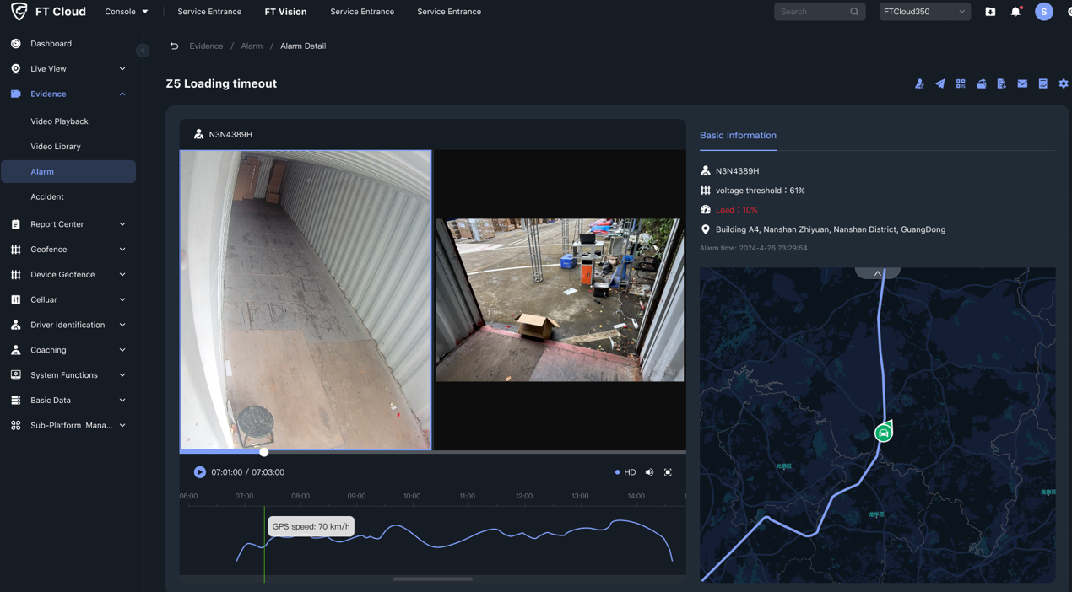
Cargo Alarm

Slide 14

How to optimize loading rate？
Improper arrangement and inefficient use of space can lead to low loading efficiency, especially for vehicles that settle payments per trip. Relying solely on manual estimation does not guarantee full capacity utilization, resulting in more trips and a significant increase in transportation costs!
Underfilled
Underfilled
Underfilled
Even after loading the cargo box, the load factor is only 60%, resulting in significant wasted space.
Notes:
货物摆放不整齐、空间利用不合理，会导致装载率低下。尤其是按趟结算运费的车辆，由于装载率只能靠人工估算，无法保证满载率，导致趟数增多、运输成本直线上升。

Slide 15

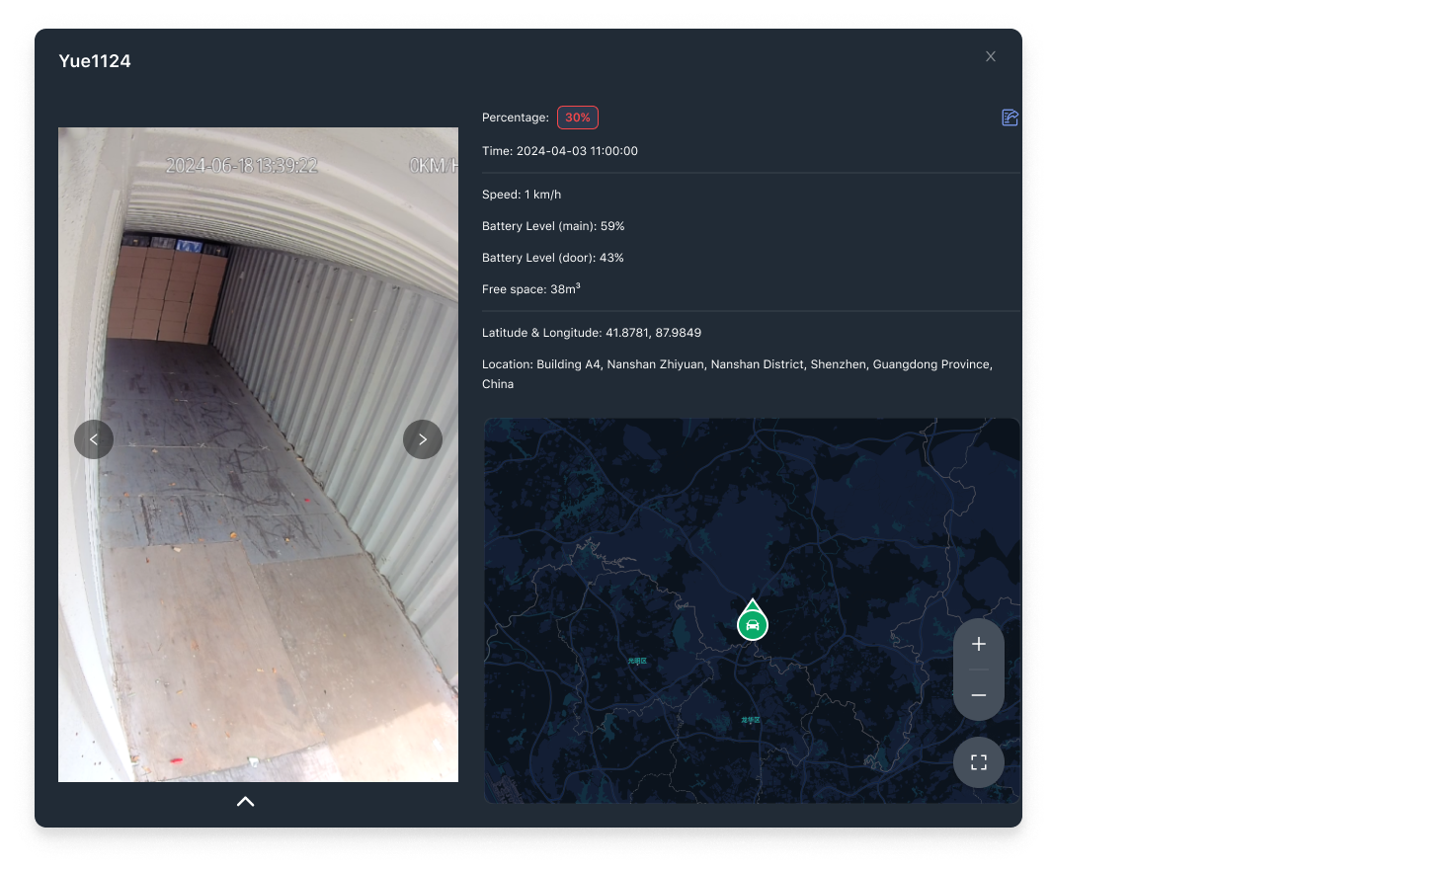

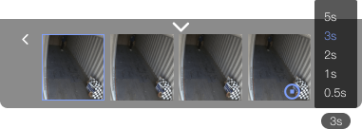
Trailer Occupancy

Slide 16

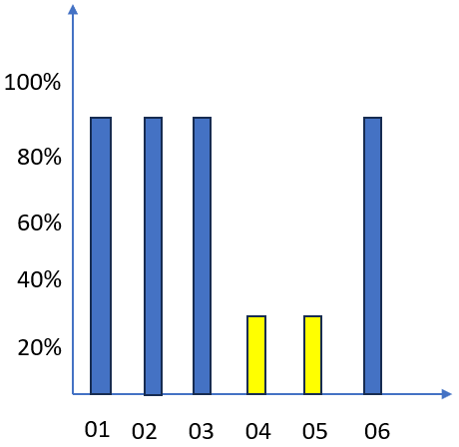



2D Visualization: Displays loading rates for each layer of the cargo hold！
Enhanced Load Management: Utilize video zoom and playback to quickly identify inefficiencies without full review.
Instant Loading Alerts: Receive real-time alerts if cargo placement fails to meet standards.
Improved Dispatch Efficiency: Estimate completion times based on loading and unloading speeds (e.g., "Expected to finish in 20 minutes").
※(Version 1.2, targeted for early 2025 release)
Empty

Slide 17
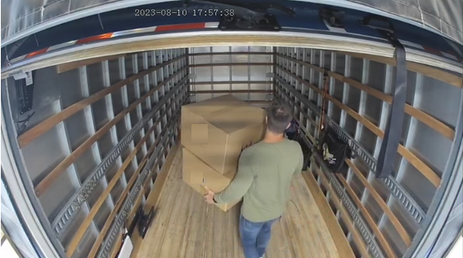
Improved loading and unloading efficiency
What could be the issue?
Low staff efficiency?
Not enough manpower?
Other goods causing delays?
This vehicle has been docked at Platform for 4hrs, and the status still shows "Loading in Progress," blocking other vehicles from accessing the area!

Slide 18

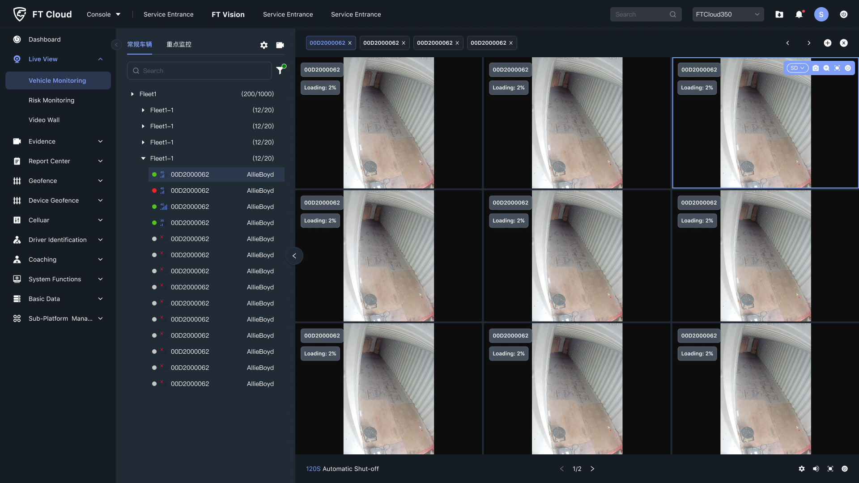
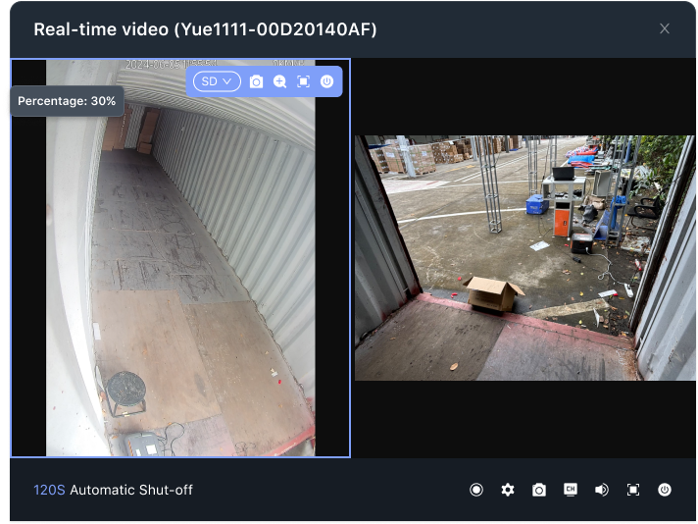
Improved loading and unloading efficiency

Slide 19
How to improve cargo container dispatch efficiency?
With hundreds or thousands of containers, which one can take an order when it comes in?
Which container is idle?
Which is closest to the warehouse?
Which has enough space to load 85m³ of goods?

Slide 20
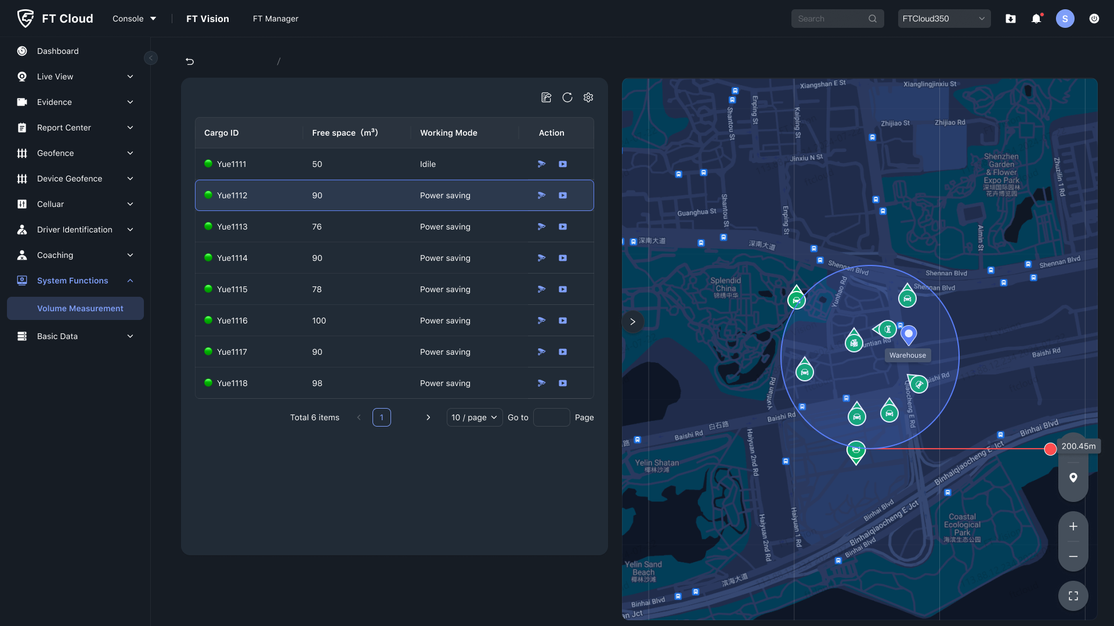
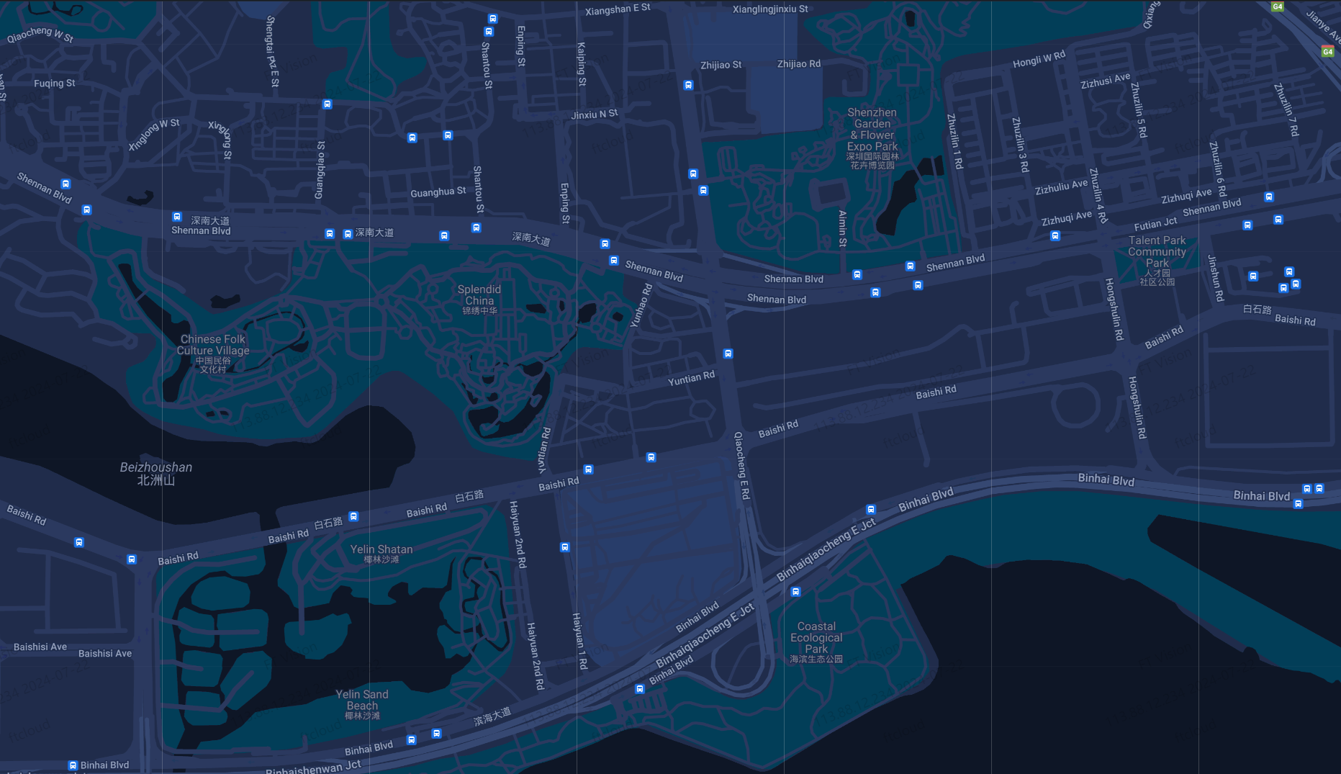
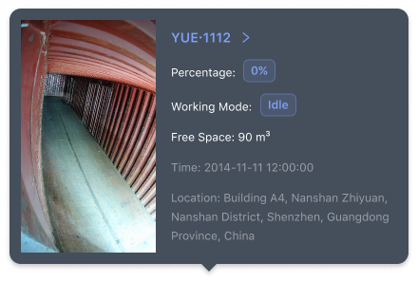
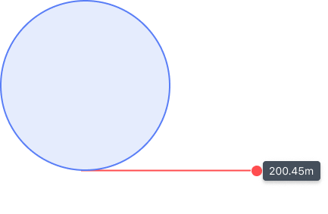

Enhancing Container Dispatch Efficiency

Slide 21
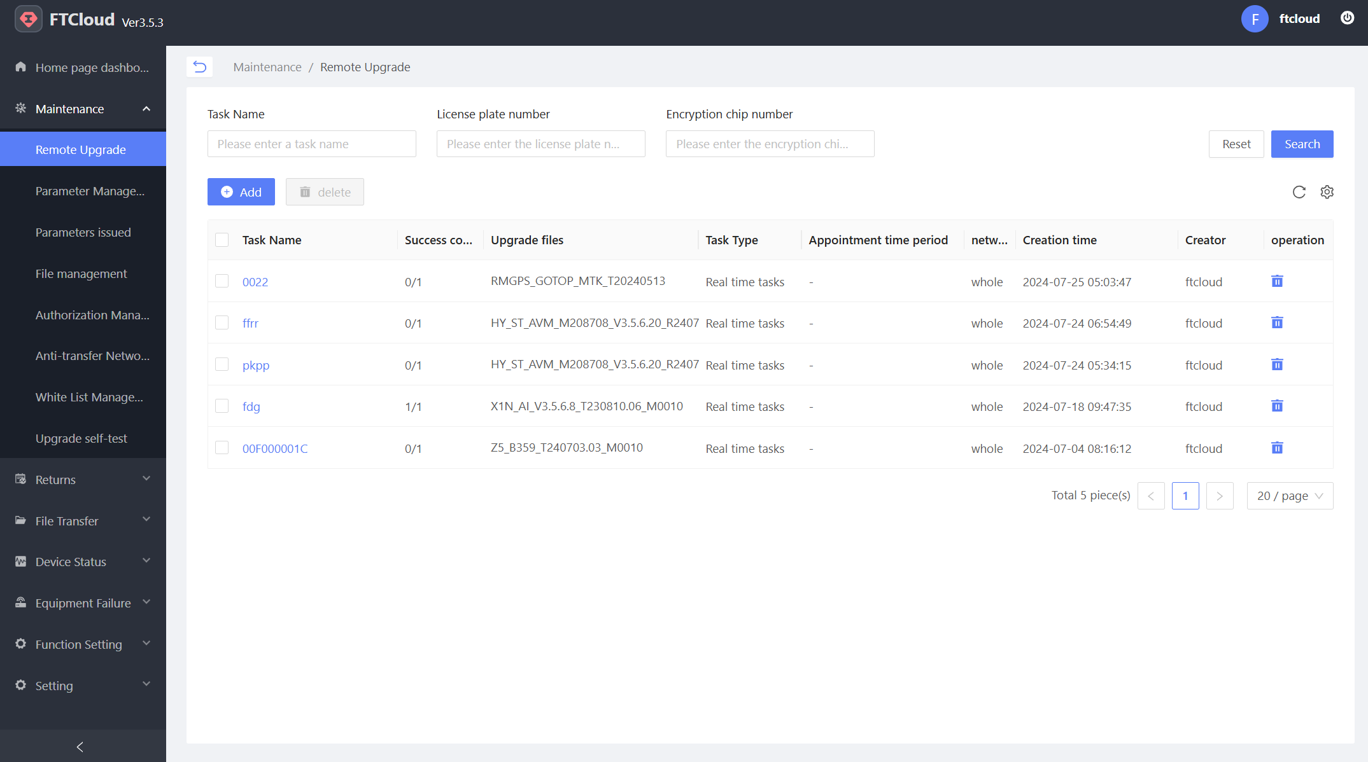
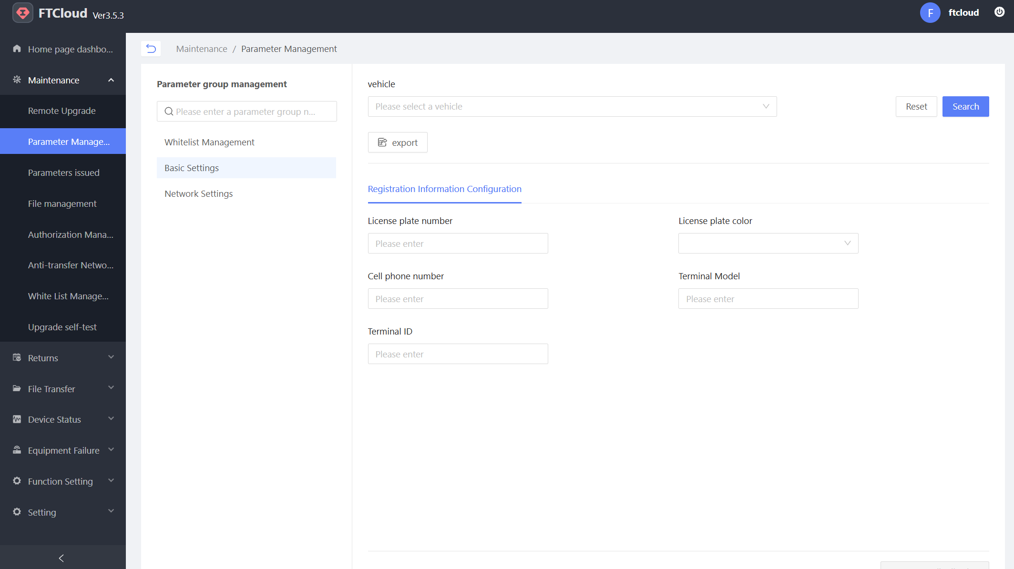
Operational Maintenance Features
Supports remote software upgrades and parameter modifications for the main unit Z5 and door sensors.

Slide 22
Product Development Milestone
24.7.31
24.10.30
H/W : Development Prototype release
S/W: Alpha Firmware release
H/W：Customer Sample release
S/W：Official Firmware release
Certification: FCC、CE、E-mark Completed

Slide 23
Marketing Material Package
Material Items | Serial number | List of Materials |  | Ready time | Note
Marketing PackagesV1.0 | 1 | Market Promotion PPT |  | √ | Market Background、Product Positioning、Core Highlights 、Competitive Analysis、Specification Comparison、Product Installation、Product Milestone
 | 2 | One-Page leaflet | Product leaflet | 9.30 | Product Core Highlight and Specification
 | 3 | Picture Category | High-definition Product Images | 9.30 | High-definition, multi-angle real photos and renderings
Product PackagesV1.0 | 4 | Solution System Connection Diagram |  | 9.30 | Solution System Block Diagram.
 | 5 | Product Specification, Size Three Views |  | 8.12 | Product Specification, Dimensional Views
 | 6 | Product Manuals |  | 9.30 | User Guide, Configuration Instructions
 | 7 | Installation Guide + Brief Installation Manual |  | 8.12 | Installation Guide
 | 8 | Saleable List + Sales Program |  | 9.30 | Main Unit + Accessories, Complete System
 | 9 | System Validation Reports, Test Reports |  | 9.30 | Verification Report, Test Report
Certification PackagesV1.0 | 11 | Emark/CE-RED/ FCC/ UKCA/ROHS/REACH/PTCRB |  | 9.30 | Certification report
Notes: The above materials are available through the link： Password：

Slide 24


Thank You!
Guardians of Road Safety

